Slide 1
Preparing Patients and Other Stakeholders to Uphold Ethical Research Principles
Human subjects protection training for patients and other stakeholders
This project is funded by a Patient-Centered Outcomes Research Institute (PCORI) Eugene Washington Engagement Award Program (EAIN-2299, PI: Bevans)
Notes:
Thank you for attending the third and final section of our three-part webinar series involving Human Subject protection challenges in PCOR. My name is Anna de la Motte and the I’m the manager of this project. The topic of our third webinar is “Preparing Patients and other stakeholders to uphold ethical research principles. The webinar includes presentations of three training programs designed to provide non-researchers with an understanding and background in human subjects protection.

Slide 2
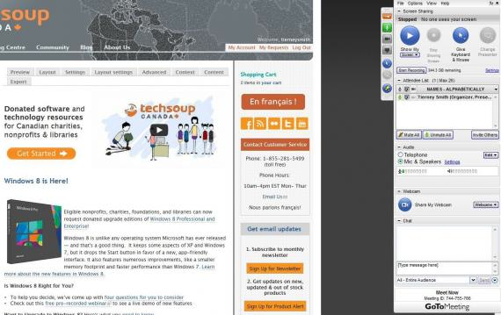
Thank you for joining!
This is the third presentation in a 3-part webinar series on the protection of human subjects in patient-centered outcomes research (PCOR)
Overview of webinar functionality
This session is being recorded
Attendees’ lines are muted. Please ask questions by:
Using the CHAT box
Note who you would like to answer your question
Notes:
Anna de la Motte (Project Manager) provide some information about the webinar platform.
I want to briefly go over a couple points regarding site functionality. First I want to point out that the session is being recorded, so that it can later be shared with others. I also want to mention that because of the size of the call, attendees lines are muted. We encourage and hope, however, that you will ask questions using the CHAT box. Please not who you would like to answer your questions, so that we know what presenter to direct the question to.

Slide 3
Next Steps: We need your input!
Role | Number of responses
Investigator/Researcher | 10 (22%)
Research Coordinator/Manager/Assistant | 17 (38%)
IRB Member or Leader | 16 (36%)
Patient or other stakeholder | 2 (4%)
We compiled your responses into a list of 22 human subjects protection initiative (specific to PCOR) on the website codigital.
The site allows participants to:
Generate new initiatives
Refine listed initiatives
Prioritize initiatives
Notes:
I want to quickly review the work that has been done so far, and give a quick plug for our final activity. Looking at the chart here, we gave elicitation surveys to attendees from webinars 1 and 2, and asked them to list human subjects protection initiatives that they thought would be of greatest importance to the PCOR community.
This chart shows the number of responses from each stakeholder group. We had a great turnout with 10 i/r responses, 17 from other study staff (including coordinators and others), 16 from our IRB members and leaders, and 2 from patients and other stakeholders.
We compiled… (specific to PCOR, as well as other types of participatory research. This list has been put up on a codigital website. Tomorrow, I will be sending a personalized codigital link that will allow attendees to participate in codigital. WE think it’s a really interesting platform that allows participants to do a number of things. Lastly, and we think most importantly, it gives people the ability to prioritize that list of initiatives. We’re really interested in seeing what rises to the top.

Slide 4
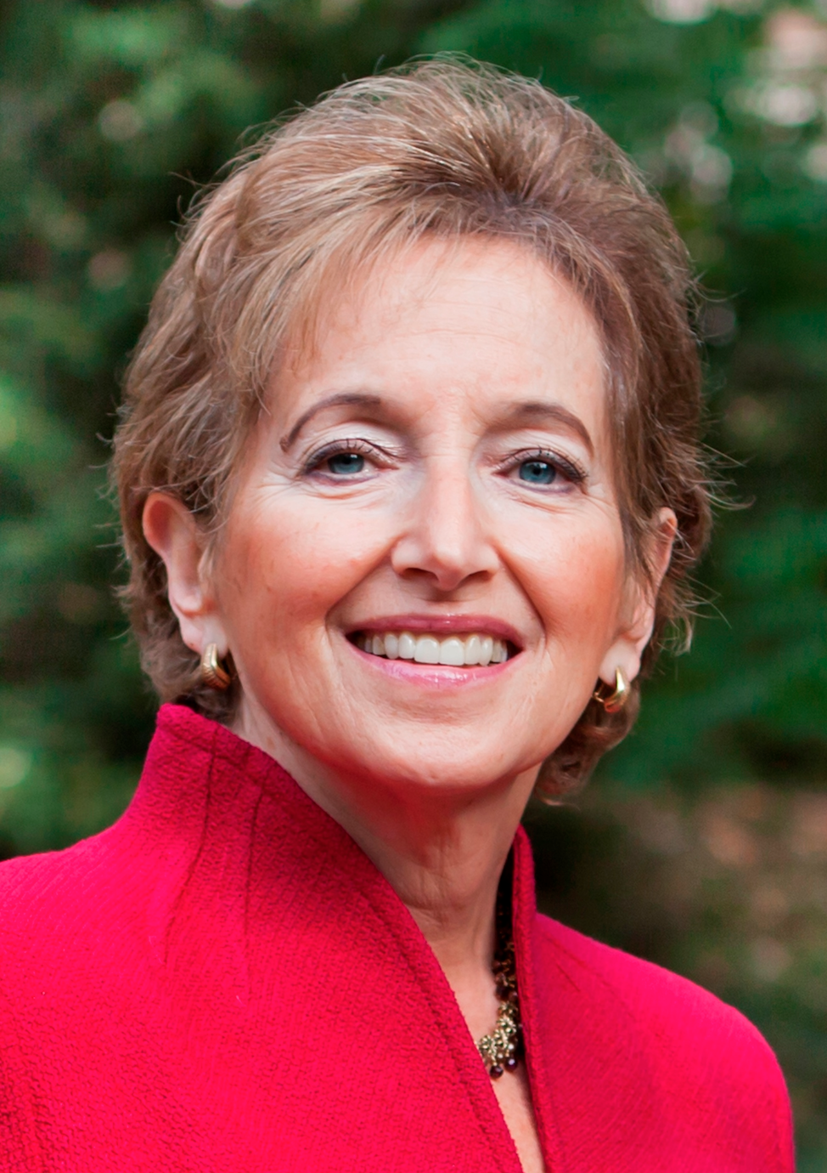
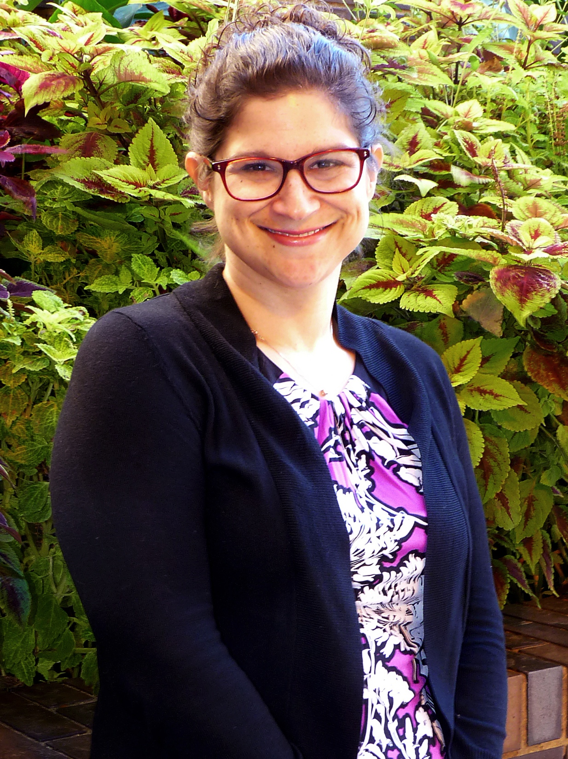
Our Presenters:
IRB Leader
Training Program Presenters
Karen Glanz
George A. Weiss University Professor
University of Pennyslvania
Megan Kasimatis Singleton
Associate Director
University of Pennsylvania
Emily Anderson
Assistant Professor
Loyola University Chicago
Stephanie Solomon Cargill
Assistant Professor
St Louis University
Notes:
Here we have our wonderful webinar presenters. First, our IRB representative Megan Singleton and Megan Morash – they’ll be providing a brief overview of the regulatory considerations regarding human subjects protection training, and then we’ll be launching into three actual training programs that have been developed for non-researchers. Those presentations will go in order, starting with Karen Glanz, a George A. Weiss university professor, Emily Anderson, an assistant professor at Loyola University in Chicago, and finally Stephanie Solomon Cargill, a professor from St. Louis University.

Slide 5
IRB Introduction to Human Subjects Protection Training
Megan Kasimatis Singleton
Associate Director
University of Pennsylvania
Notes:
I want to start by introducing our IRB team members: Megan Morash, an IRB Chair at Partners Health care, and Megan Singleton from the University of Pennsylvania. Megan Morash is going to start the discussion.

Slide 6
Training: Factors to Consider
Applicable regulatory & funding requirements for training:
NIH
FDA
Accrediting Entities for Human Research Protections Programs
Institutional Requirements
Notes:
Depending on the research study and the roles of the community stakeholders as advisors or study team members, they may be considered “engaged” in human subjects research and various training requirements [imposed by research institutions, external funding agencies, federal oversight agencies or accrediting bodies] may apply. It is important to consider that while many oversight entities do not specify the training program that must be used to satisfy these requirements, many academic and research institutions, as a matter of policy, have designated a specific training program they believe satisfies the requirements. More broadly, these training requirements generally mandate that the training will be adequate to ensure a) familiarity with the protocol, b) familiarity with any institutional policies pertaining to the conduct of research and c) the ability to carry out designated roles and responsibilities in accordance with applicable laws and regulations.

Slide 7
Research Staff Human Subjects Training
Member of a committee reviewing identifiable health data
Co-investigator or study staff
Scientific study design
Recruitment based on private health information (PHI)
Data collection including PHI
Informed consent process
Analysis of identifiable data
On or off-site study coordinator
Focus group participation
part of the research activities
answers research questions
Notes:
There are well established human subjects training courses for research study staff, most common is the CITI course, which is available online. Most research institutions subscribe on behalf of their researchers and require documentation of training prior to initiating their research study. Other entities, such as NIH, and academic medical centers have their own courses. The roles and activities listed here provide a range of study staff roles in which human subjects training would be clearly required.

Slide 8
Training: Factors to Consider
General Content
Foundational Ethical Principles for Human Subjects Protections
Research Methodology
Responsible Conduct of Research
Tailored Content
May depend on designated roles and responsibilities
e.g. those charged with consenting or adjudicating events that occur on a study may need specific training to perform these tasks
Tailored content may need to focus on a) the practical aspects of performing the task and b) the applicable regulations/protections related to the task

Slide 9
Patient and Other Stakeholder Research Training
Research planning committee to formulate research questions
Preparatory focus group informing research questions
Review and advise on protocol development or study endpoints
Participate in a stakeholder meeting
Advise or participate in grant writing, or survey development
Participate in a patient advisory panel to a research project
Notes:
The area that is less defined is the non-study staff, or stakeholders or advisors who contribute to PCOR research. What type of human subjects training is required? Before we answer that question, we need a tool to figure out what roles fall into this group. The above roles and activities are good examples of contributors to the overall research project, but those who are not necessarily directly involved in human subjects research activities.

Slide 10
Training: Factors to Consider
Formatting:
Human Subjects Protections, RCR and GCP courses are now primarily offered online
Alternative formatting may be considered for community stakeholders to address the following:
Responsiveness to a variety of learning styles
Affording an opportunity for interaction/questions
Potential limitations on resources needed to complete the training online
Course customization/tailoring to address the specific roles of community stakeholders

Slide 11
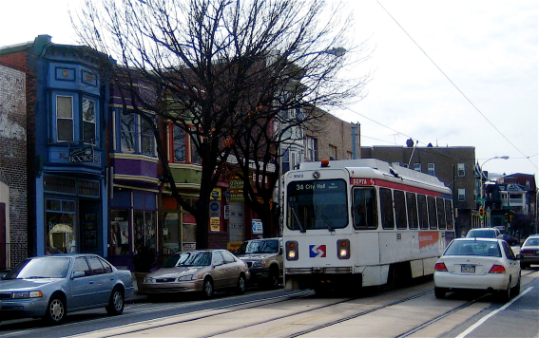
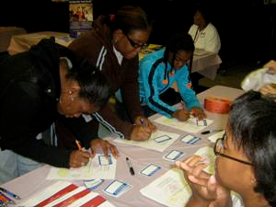
Training in Responsible Conduct of Research in the Community
Karen Glanz, PhD, MPH
Director, CTSA Community Engagement and Research (CEAR) Core

Slide 12
Community Engagement and Research (CEAR) Core
UPenn Clinical & Translational Science Award (CTSA)
The broad purpose of the CEAR Core is to facilitate initiatives in community-engaged research, collaboration, and team science.
This is achieved through:
Engagement of a variety of communities and stakeholders
Fostering collaborations across institutional units (schools, programs, centers) at UPenn and CHOP
Assessing community health needs and priorities
Advancing translation of research through local and nation collaborations

Slide 13
Regular meetings with representation from CHOP, key Penn Schools (Medicine, Nursing, Dentistry, Education, Arts & Sciences, Social Policy & Practice, Wharton), and Centers (Center for Public Health Initiatives, Netter Center for Community Partnerships, Office of Government and Community Affairs)
When discussing barriers to engaging community in research, difficulty with training community members in research ethics was a common frustration
Current training program (CITI) requires university email
Difficult for lay person to understand
These conversations sparked an idea for community-friendly training program
CEAR Core Steering Committee

Slide 14
Research Regulations
The federal government has made laws for how research should be done
Protecting participants
Informing participants
Reviewing research before it starts
Everyone doing research must follow these rules
Institutional Review Boards (IRBs) enforce these rules at the local level in order to protect the rights and welfare of participants

Slide 15
Training Requirements
Those engaged in research are required to complete training in the protection of human subjects.
This can be fulfilled by the CITI (Collaborative Institutional Training Initiative) online-training program:
https://www.citiprogram.org/
"To promote the public's trust in the research enterprise by providing high quality, peer reviewed, web based, research education materials to enhance the integrity and professionalism of investigators and staff conducting research."
CITI Program Mission Statement

Slide 16
Community Research Partners
Community-engaged research might include partners from:
Community organizations
Patients
Religious congregations
Neighborhoods
Community research partners may be involved in research by:
Participating in a Community Advisory Boards
Providing input on recruitment methods
Collecting data
Helping to disseminate information

Slide 17
Requirements for Community Research Partners
In certain circumstances, community partners may be considered investigators who are “engaged” in the research, and human subjects research training is required (CITI Certification)
The activities that qualify a collaborator as an investigator include:
Interacting or intervening with research participants
Consenting participants
Participating in the collection of or having access to identifiable data

Slide 18
CITI Certification
Required by the University
Challenges: University affiliation needed to access (i.e., employee or student), assumes background knowledge on research
CIRTification Program
Developed at the University of Illinois at Chicago
Designed as a substitute to CITI Certification
Better suited to the needs of community partners:
Addresses ethical issues in plain language
Uses real-world examples
Focuses on the application of new knowledge
Includes participatory activities such as brainstorming, case-based discussions, and role playing
Challenges: Designed to be delivered in-person, workshop takes 3+ hours to complete

Slide 19
Online training platform featuring materials from the CIRTification curriculum
Includes education, resources activities, quizzes, and certificate at completion of training
Two types of accounts: Principal Investigator/ Research Coordinator and Community Partner
Training in Responsible Conduct of Research in the Community
A collaboration between the Community Engagement and Research (CEAR) Core of the UPenn CTSA and the UPenn Office of Regulatory Affairs, Human Research Protections

Slide 20
Working with local web development firm
User experience interviews/workshop included academic and community perspectives
Website will launch within the next month
Select research staff and community partners will pilot training program prior to wide dissemination throughout the university
Training in Responsible Conduct of Research in the Community
A collaboration between the Community Engagement and Research (CEAR) Core of the UPenn CTSA and the UPenn Office of Regulatory Affairs, Human Research Protections

Slide 21
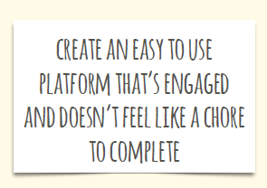
User Experience and Design Process
Met with web developer to discuss visual preferences, audience experience, and website flow
Minimal, clean, visual interface
Ability to track and save progress
Use of simple language

Slide 23
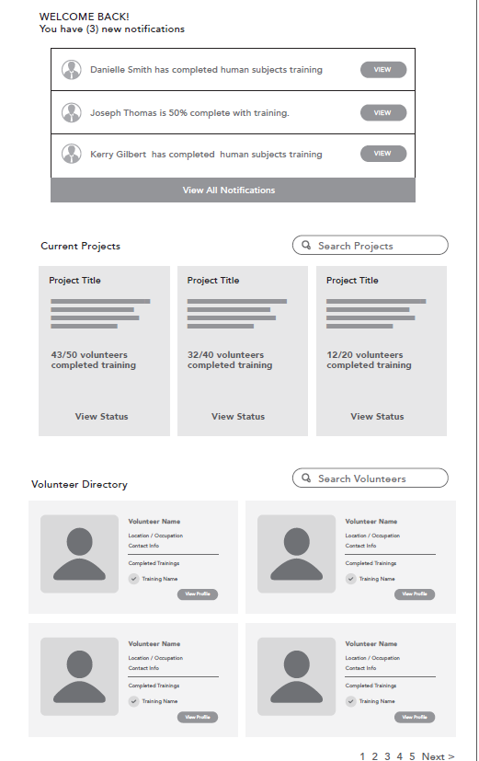
Principal Investigator/Research Coordinator Account
Create research projects
Assign community partners (CPs) to research projects
Invite CPs to complete training via unique link
Monitor CP training progress
Access CP completion certificates
Search for CPs in directory to check if they previously completed training

Slide 24
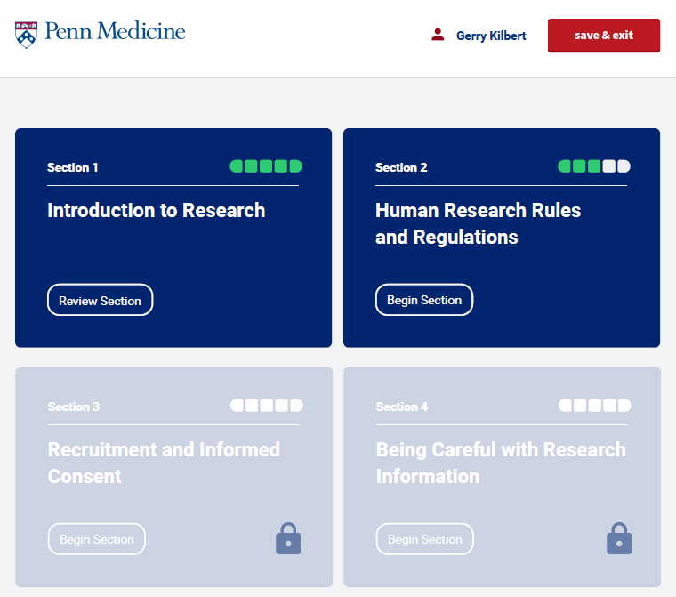
Community Partner Account
Access training modules (4 sections) and resources:
Introduction to research
Human research rules and regulations
Recruitment and informed consent
Being careful with research information
Save progress and return
Access completion certificate
Can go back and review training module content at any time

Slide 25
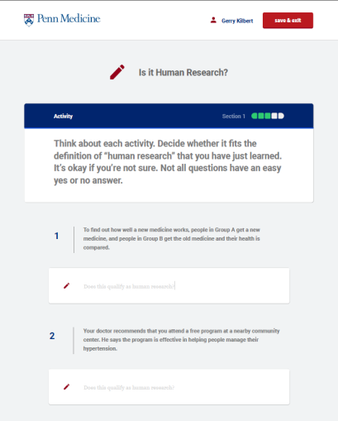
Notes:
Examples of education and activity

Slide 26
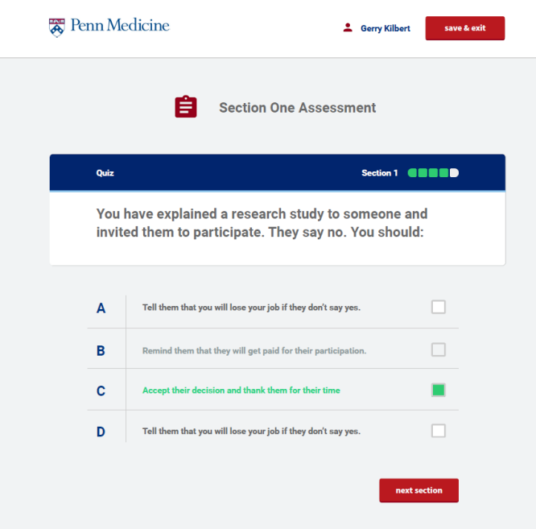
Notes:
Example of quiz – there is a quiz at the end of each of 4 sections. Must answer all questions correctly to proceed to next module. Can go back and review training information if you get question(s) wrong.

Slide 27
Summary
Covers same content/major topics as CITI training, presented in a community partner friendly format
Training website allows for wide dissemination, completion at user’s convenience, and easy tracking of users and their progress
Quality assurance – research staff responsible for monitoring CP training progress; CEAR Core staff available for troubleshooting
Testing understanding/knowledge – Interactive activities and quizzes; CPs must answer all quiz questions correctly to complete training

Slide 28
Questions?
Acknowledgements
Sara Grossman, MPH
Sarah Green, MPH
P’unk Ave
CEAR Core Steering Committee
Usability Testers
Karen Glanz, PhD, MPH
kglanz@upenn.edu
Notes:
Thank you, Karen! Our next presenter is Emily Anderson, a professor at Loyola University in Chicago

Slide 29
Community Involvement in Research Training: CIRTification and Informed Consent in Action
Emily E. Anderson, PhD, MPH
Loyola University Chicago
Neiswanger Institute for Bioethics

Slide 30
Funding Acknowledgment
CIRTIFICATION
University of Illinois at Chicago (UIC) Center for Clinical and Translational Science (CCTS), Award Number UL1RR029879 from the NIH National Center For Research Resources
the C3 consortium of Chicago area CTSA-funded community engagement cores, funded by the Otto S.A. Sprague Memorial Institute
INFORMED CONSENT IN ACTION
UIC Center for Excellence in Eliminating Disparities (CEED), Award Numbers P60MD003424 and P60MD003424-02S1 from the NIH National Institute for Minority Health and Health Disparities

Slide 31
Need
Community partners working with multiple academic institutions in Chicago
Each institution requiring different (yet very similar) HRP training
CTSA consortium provided unique opportunity to address this challenge

Slide 32
CIRTification Philosophy
Focus on interactions with human research participants and handling of data
Emphasize importance of protecting and respecting research participants
NOT promote idea that all things IRB-related are red tape, paperwork, only about compliance, hoops to jump through, less important than recruitment and collecting data, etc.
Build skills and capacity
Empower partners to contribute to their respective research teams as co-researchers
Notes:
Flexible
Delivered by a human in group setting
Focus on practical skills and day-to-day situations
Team-based and role specific
Easily integrated with protocol specific training
Emphasize communication, asking questions, speaking up
Training is not a “one and done”; continuing education and support critical

Slide 33
Development
Focus groups with academic and community research partners
Discussions with IRB decision makers
Diverse advisory board
Practice sessions
Many revisions!

Slide 34
CIRTification: Community Involvement in Research Training
Freely Available @
http://www.ccts.uic.edu/repository/cirtification

Slide 35
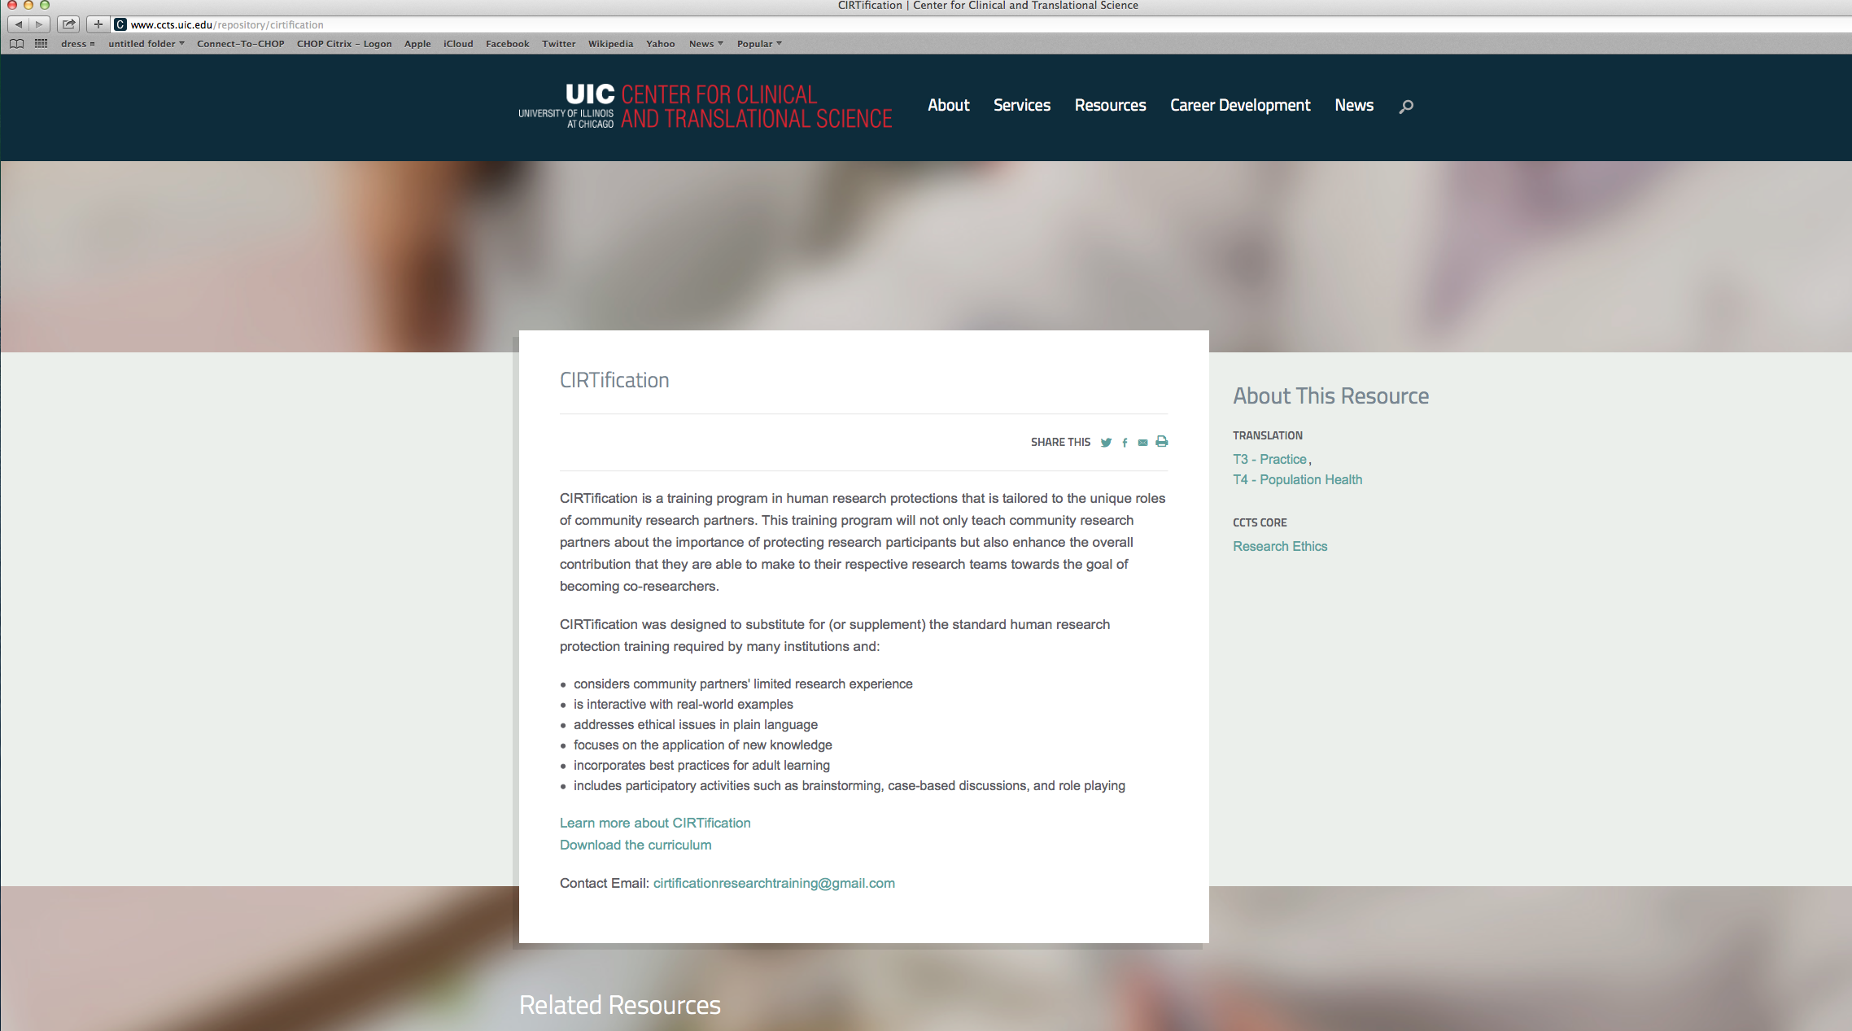

Slide 36
CIRTification Overview
Facilitator Manual
Session Objectives/Key Messages
Lay language glossary
Background reading
Lesson Plan
Powerpoint slides and lecture notes
Activities
Handouts
Discussion Guides
Participant Workbook
Lay Language Glossary
Summaries and take home points
Activity materials
Space for note taking
Part 1: Human Research Rules and Regulations
What is research?
Historical perspective
Principles, Regulations, and IRBs
Research with Communities
Part 2: Asking People to Participate in Research: The Informed Consent Process
Elements of Informed Consent
Model Consent Form
Role Play Activity
Part 3: Being Careful with Research Information
Data integrity
Privacy and confidentiality
Speaking up
Notes:
And importantly resources to help you “sell” to your IRB

Slide 37
Mode of Delivery
Pressure to create something online
Strong belief (and evidence) that in-person group learning best
Primary goals
Support the efforts of well-intentioned PIs
Be acceptable to IRBs
Engage learners
Notes:
What makes CIRtification attractive?
TO: Human Research Protections Administrators
Comprehensive coverage of standard HSP topics
Cross comparison with “CITI” online modules
Experienced trainers available
To: Academic Investigators
Readily available materials; No need to reinvent the wheel
Low burden on staff and community partners
Acceptable to IRBs
To: Community Research Partners
Low burden
In person, interactive
Directly applicable to everyday roles

Slide 38
INFORMED CONSENT IN ACTION
A training video for those who will be recruiting participants and obtaining informed consent in community based research settings
https://www.youtube.com/watch?v=i3_z04pTnN8&index=6&list=PLooXaTYiXhKUQFNbikn5aqWvi8A1WX61h
Recruiting people you know
Making sure participants understand
Ensuring voluntary participation
Inclusion/exclusion criteria
Notes:
Still felt that something was missing
Goals to show community partners as experts
Discuss lessons learned but not compare good vs. bad
Show the kinds of questions that participants might have
Demonstrate link between properly recruiting and obtaining informed consent and study follow up
Understanding/examples of valid informed consent (@ 5:30) show 1-2 minutes
Voluntariness discussion 0:00 – 1:37
Voluntariness scenario 3:10-6:00/6:00-6:48 discussion

Slide 39
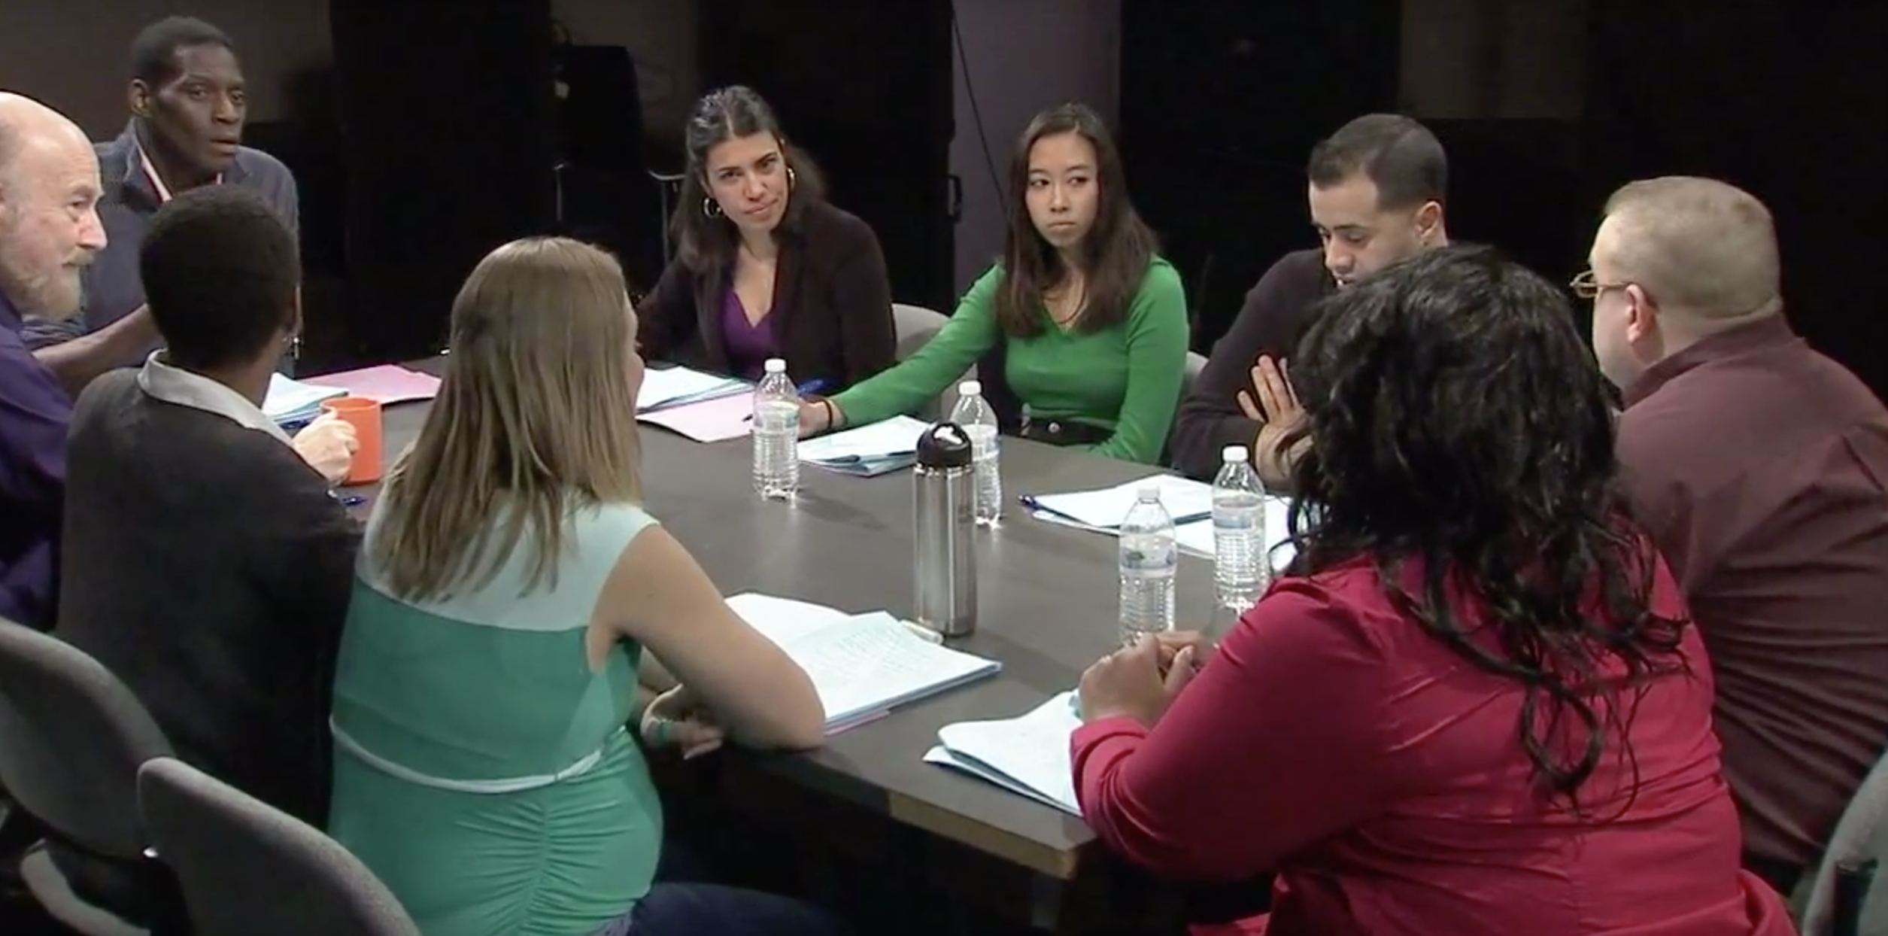
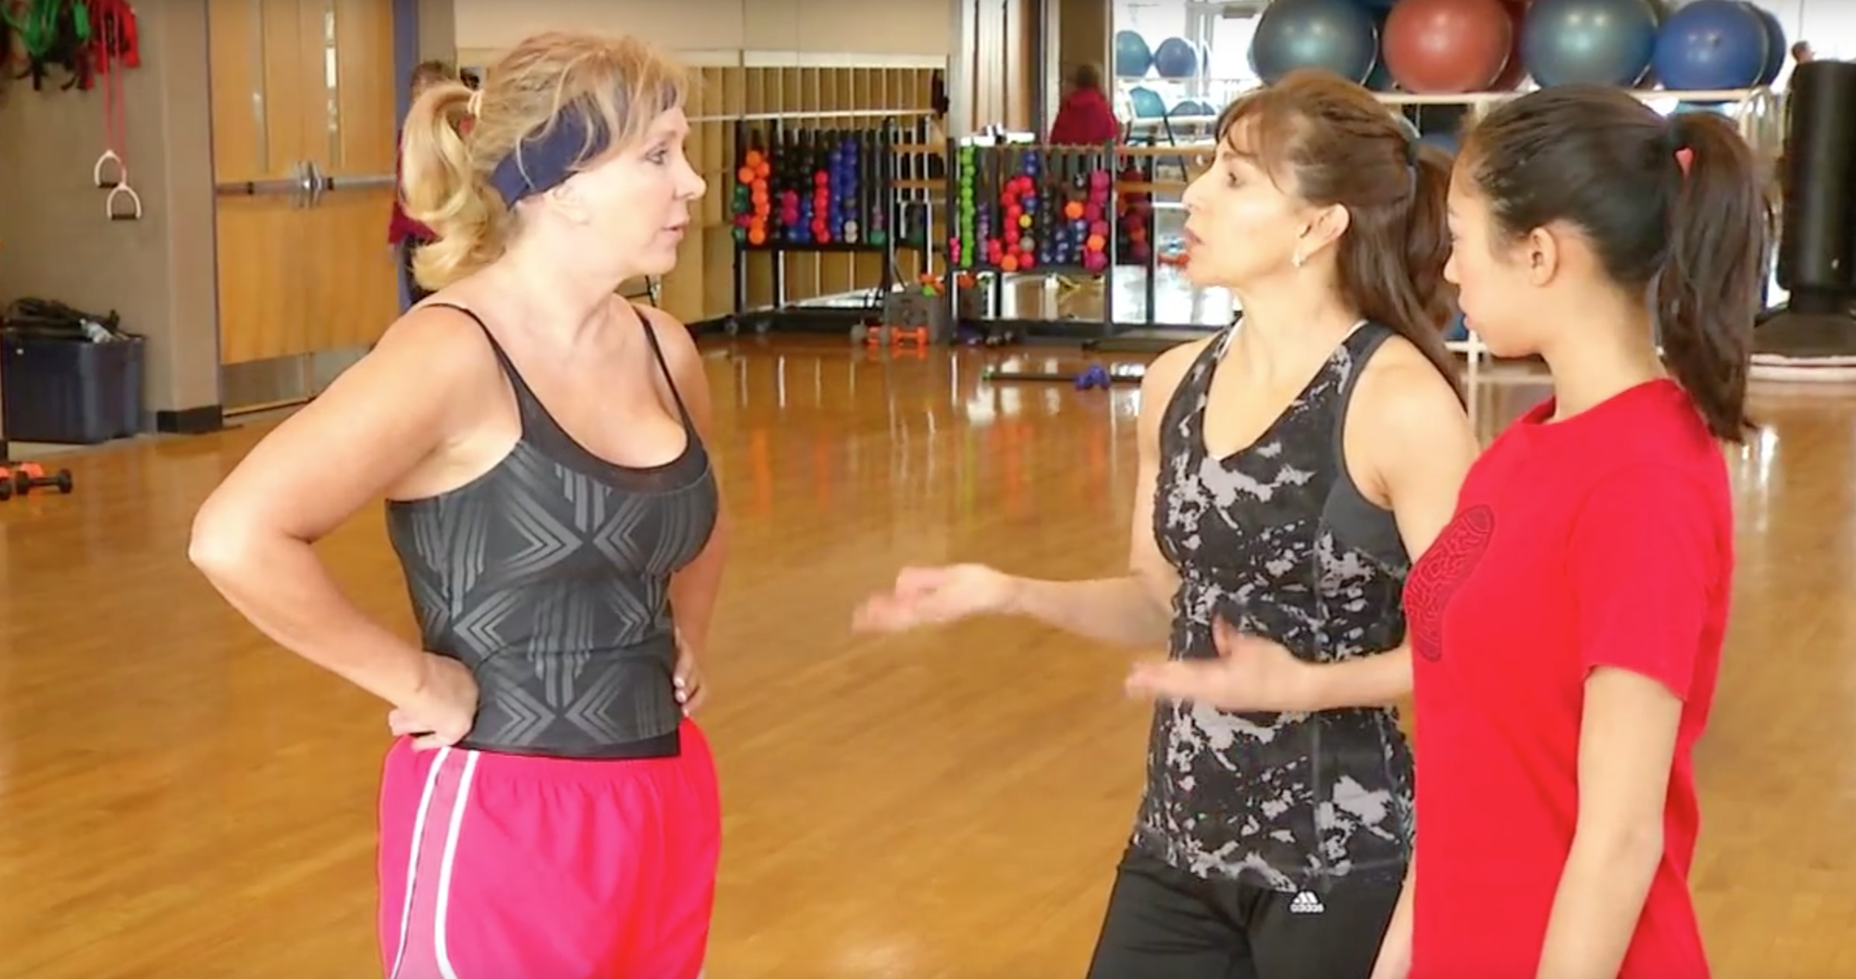
Roundtable discussions present a group discussion of issues involved with consenting members of the community
Real-world scenarios demonstrate the difficulty of recruiting people who are part of your community

Slide 40
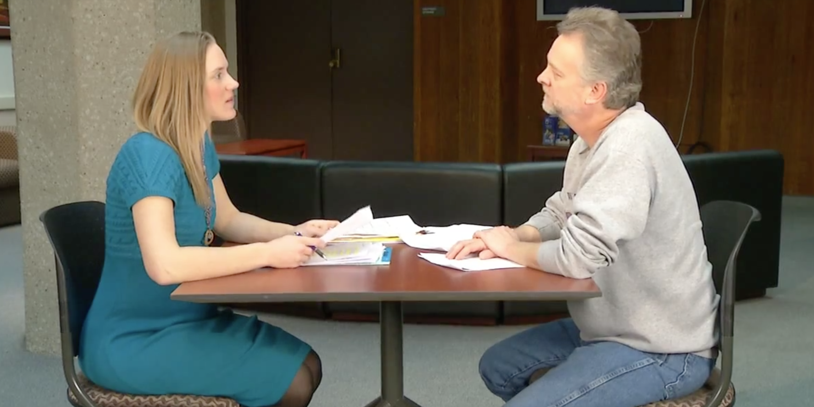
This video presents an example of how a research study should be explained to a community member, so that they know all of the important details when making their decision

Slide 41
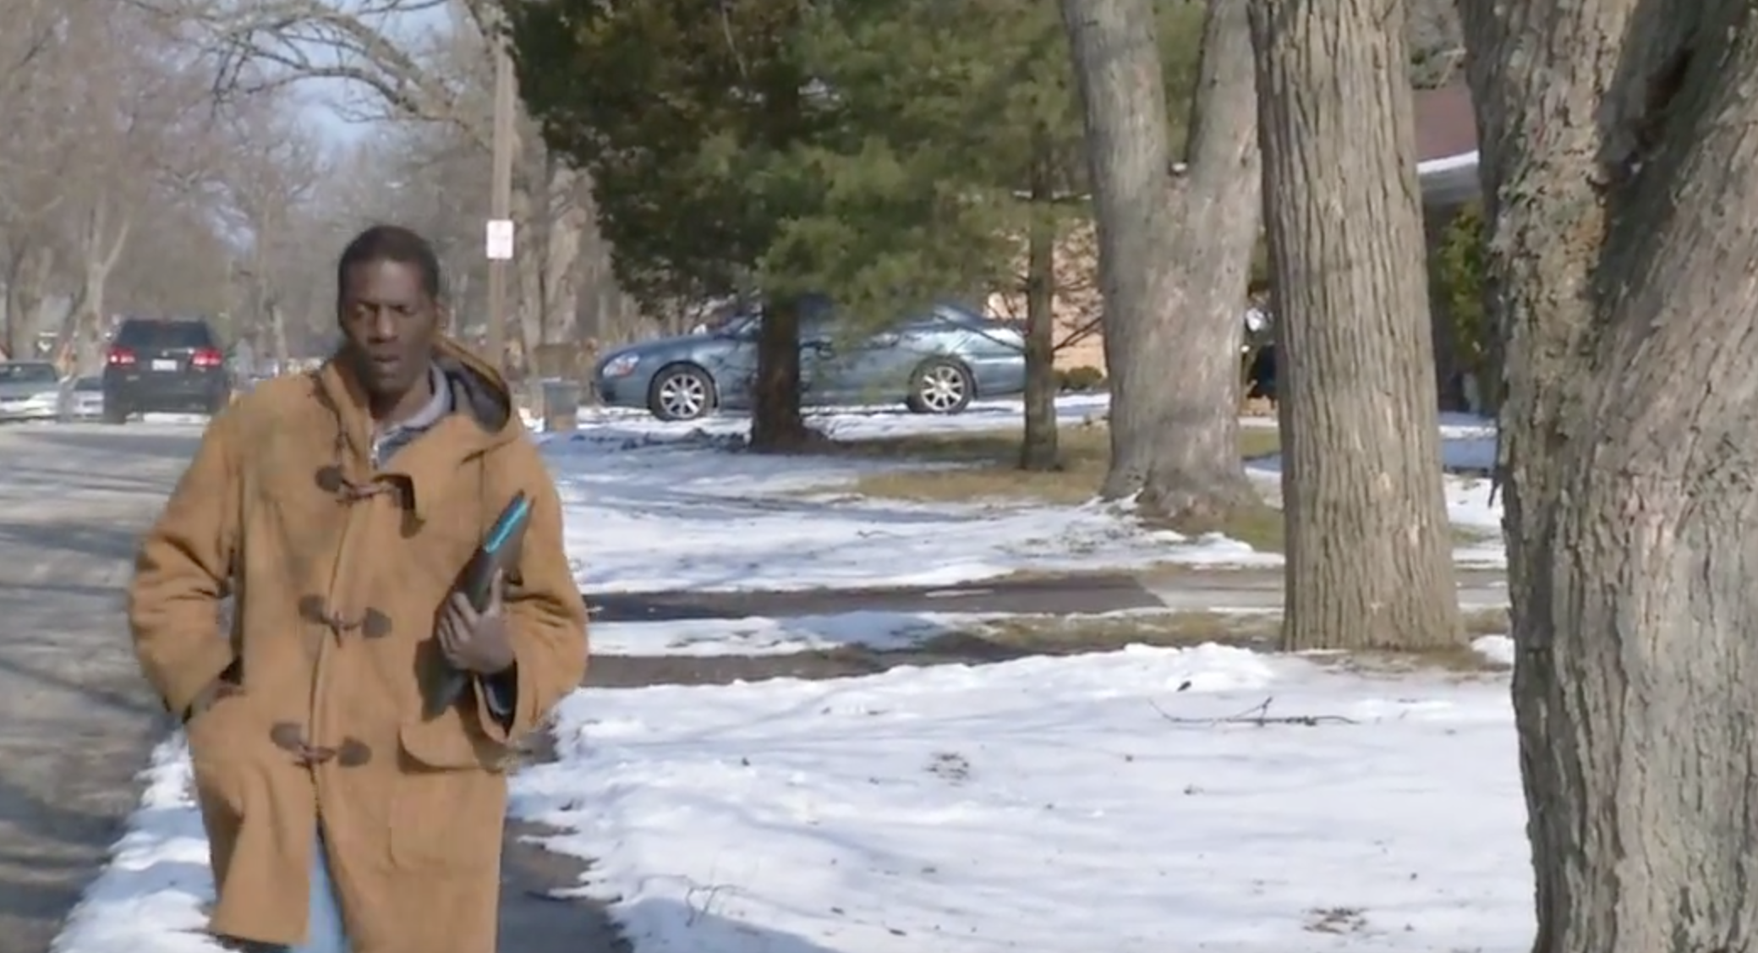
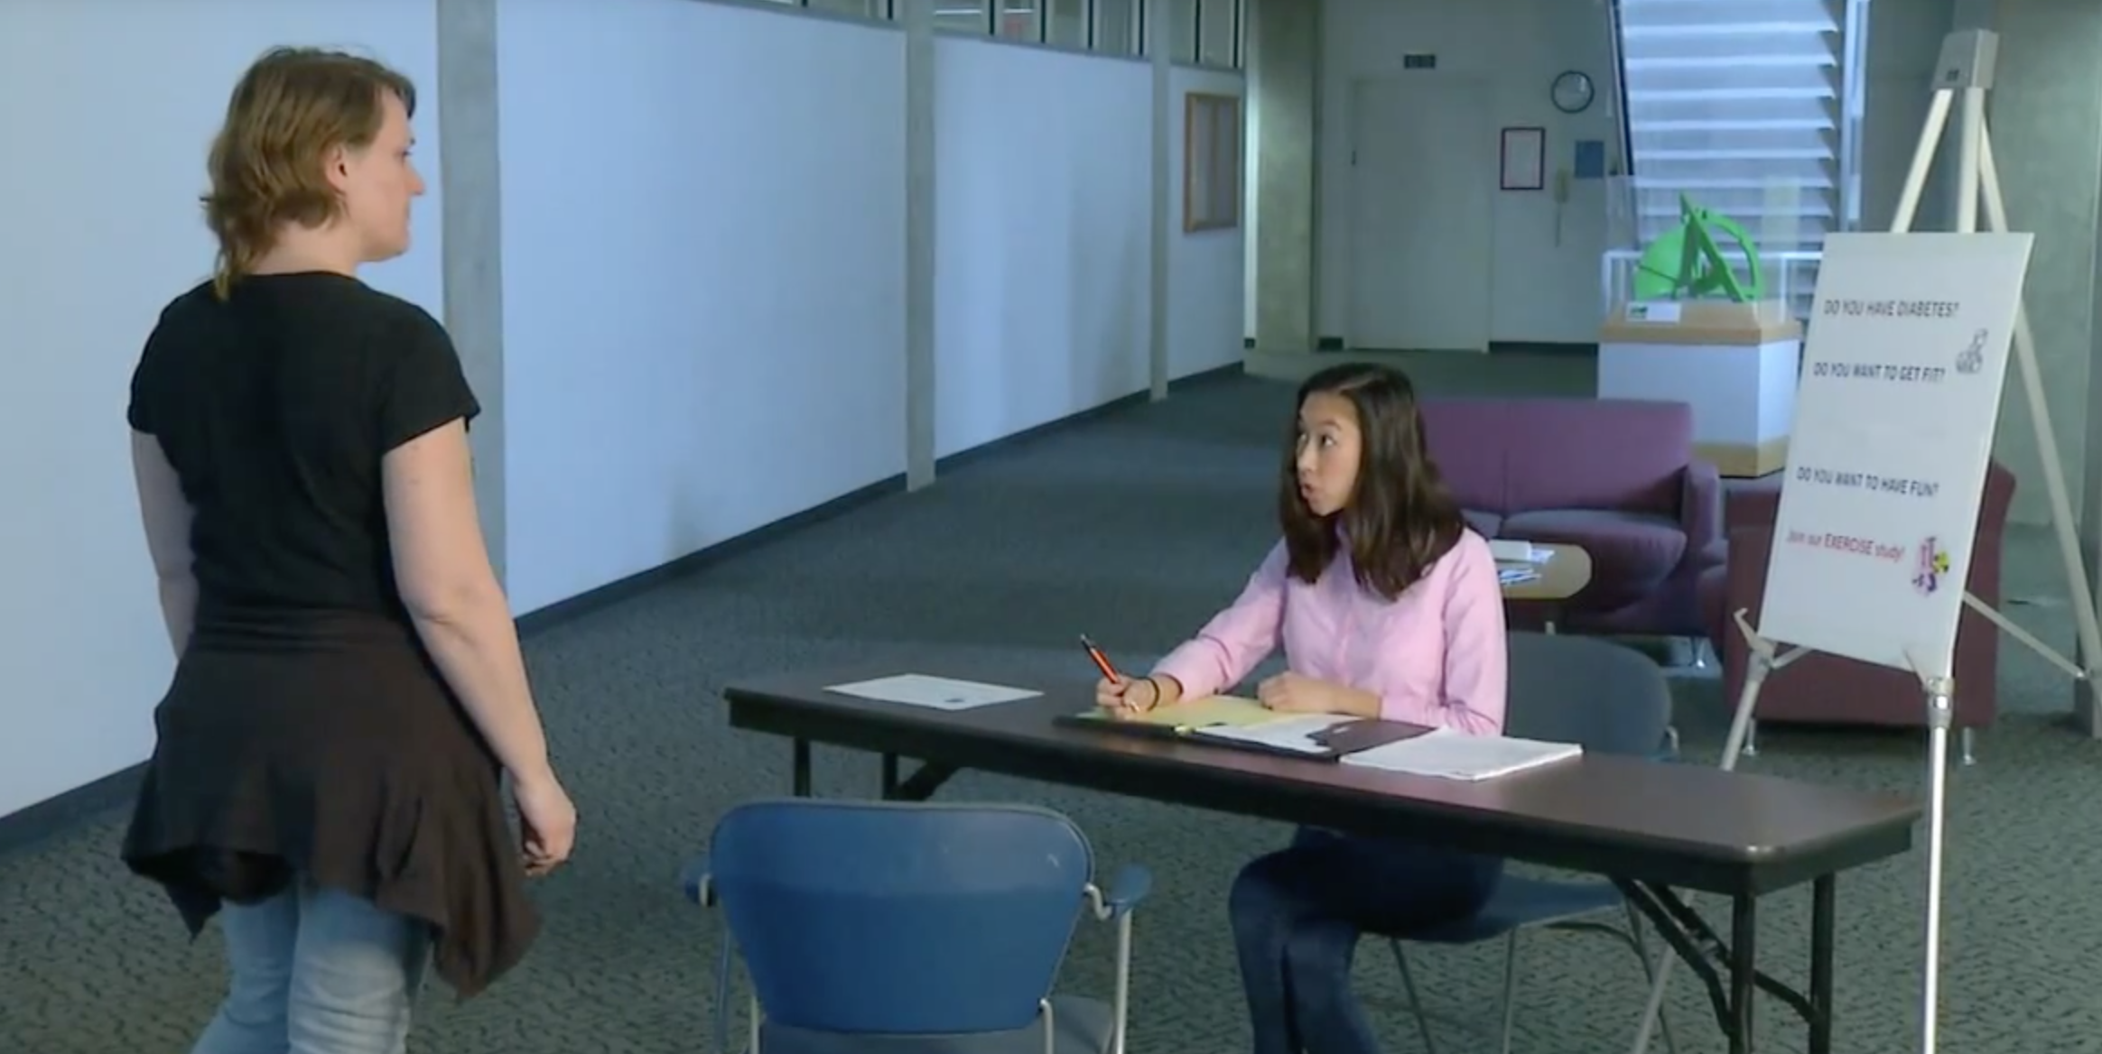
Discussion of how to solve problems that may arise in the field

Slide 42
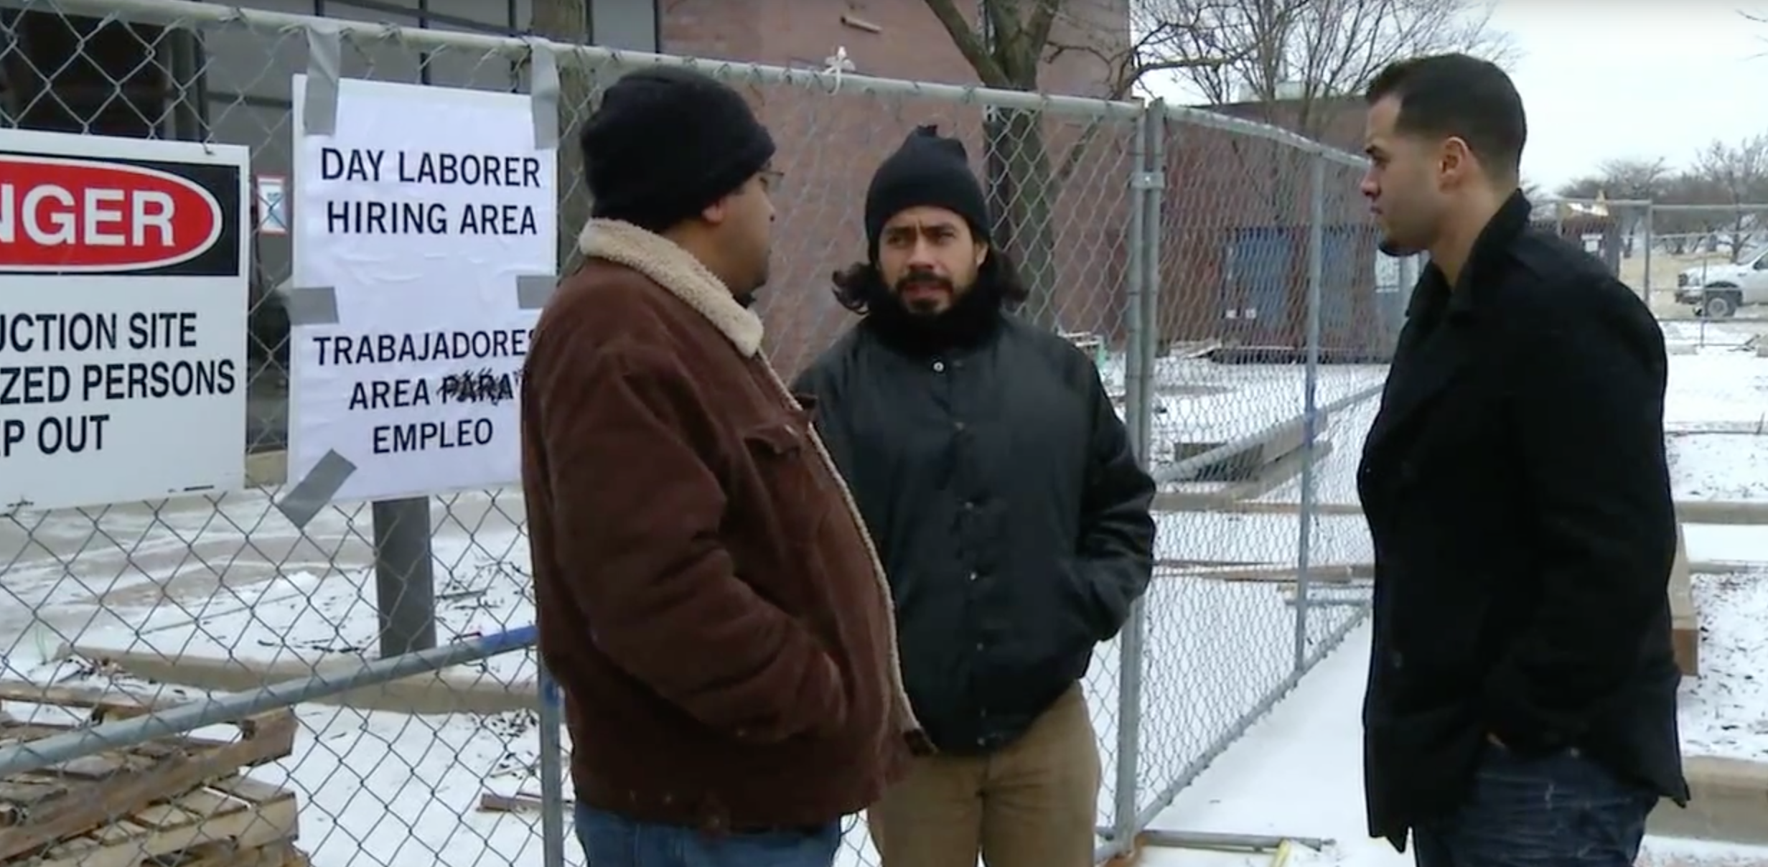
Unique issues that may arise in special vulnerable populations

Slide 43
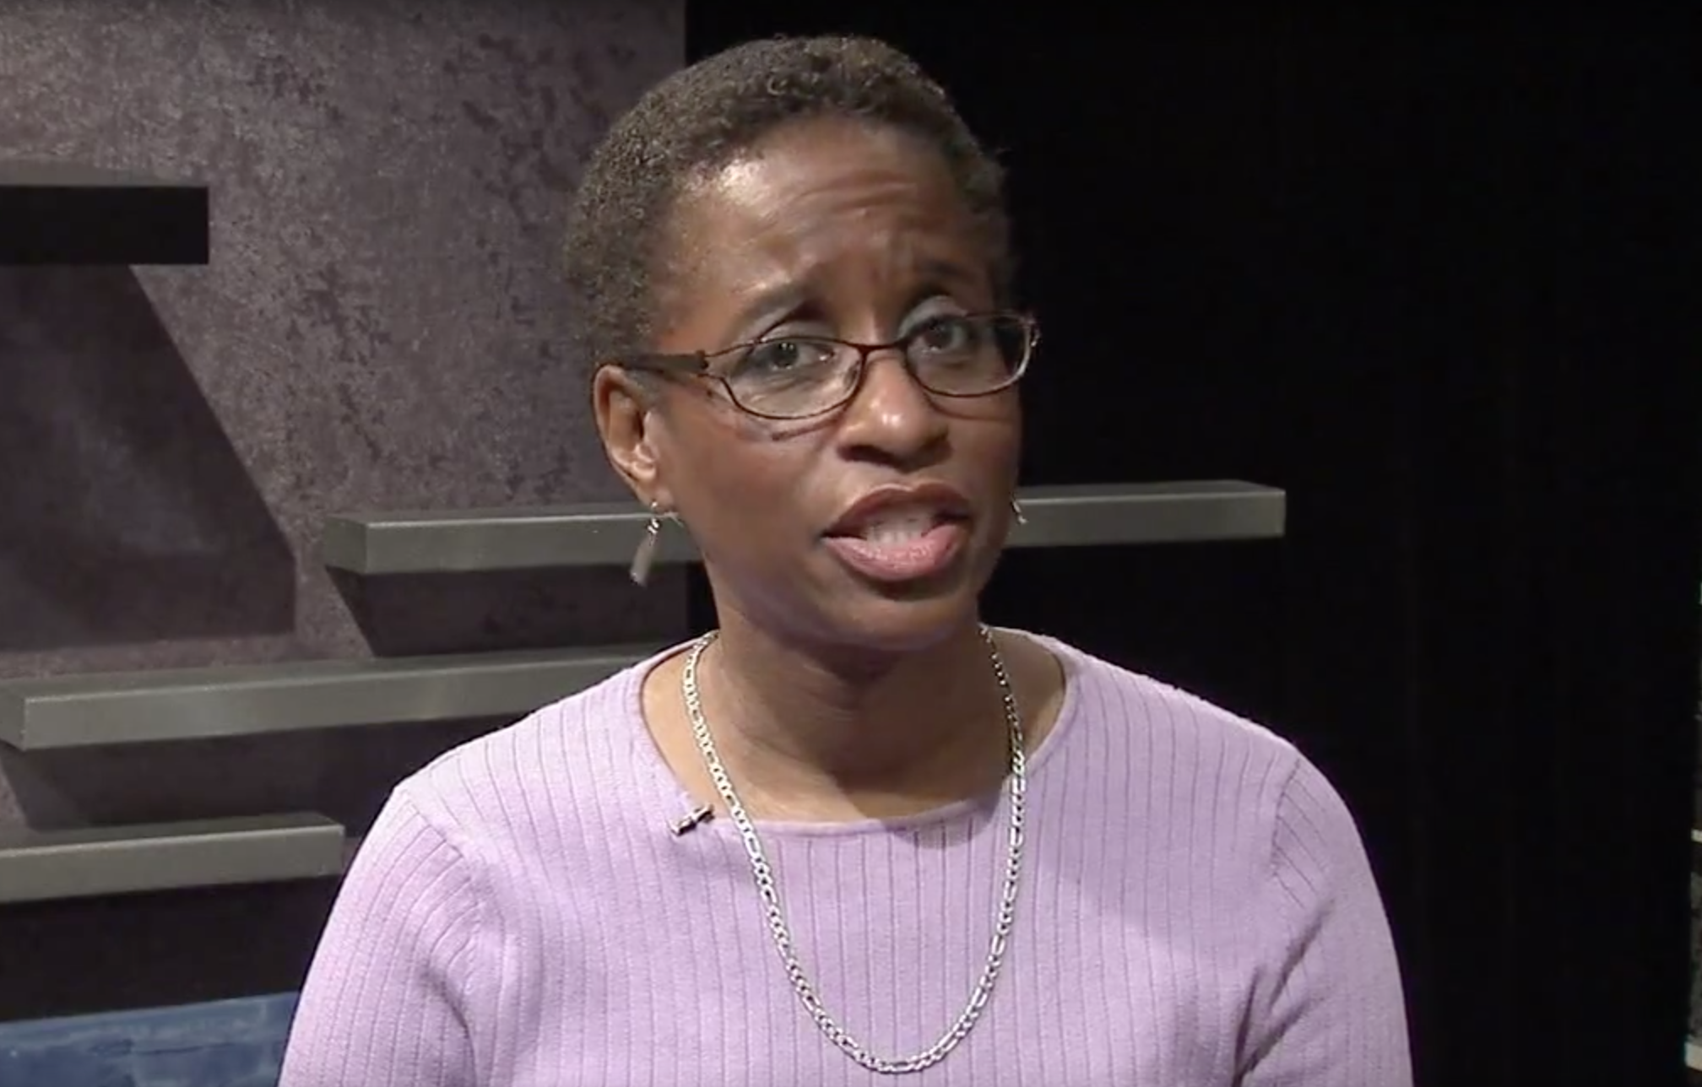
Summary of key issues to remember when obtaining informed consent- delivered by experienced community partner experts

Slide 44
Ethical Protections in Community-Engaged Research
Stephanie Solomon Cargill
http://inventions.umich.edu/technologies/4768_ethical-protections-in-community-engaged-research

Slide 45
Process
Consult with IRB and community partners on appropriate content
Create local training for community partners
Pilot local training with community partners in Flint, Detroit and Ypsilanti, MI
Incorporate activities and role-plays
Apply and receive CTSA-supplement to adapt training for national implementation at CTSA sites
Develop novel process for training facilitators and participants
Augment original training with adaptable content [ex. Videos, activities]
Develop train-the-trainer materials
Evaluate (pre and post tests; facilitator surveys)

Slide 46
If you want to know more. . .
Solomon, S., Bullock, S., Calhoun, K., Crosby, L., Eakin, B., et al. (2014). Piloting a nationally disseminated, interactive human subjects protection program for community partners: Unexpected lessons learned from the field. Clin Trans Sci, accepted.
Solomon, S., Eakin, B., Kirk, R., Piechowski, P., Thomas, B. (2014). Piloting a nationally disseminated, interactive human subjects protection program for community partners: Design, content and evaluation. Clin Trans Sci, accepted.
Notes:
Process or results of study

Slide 47
Content
The training program is divided into four* modules (~1 hour each):
Module 1: Discusses the history, purpose, and relevance of current regulations to community partners.
Module 2 Translates legalistic informed consent requirements into practical and relevant issues.
Module 3* Allows participants to practice the skills they learned regarding informed consent in various activities.
Module 4 Good clinical practices, including conflict of interest, communication with partners and IRBs, and materials to facilitate IRB relationship.

Slide 48
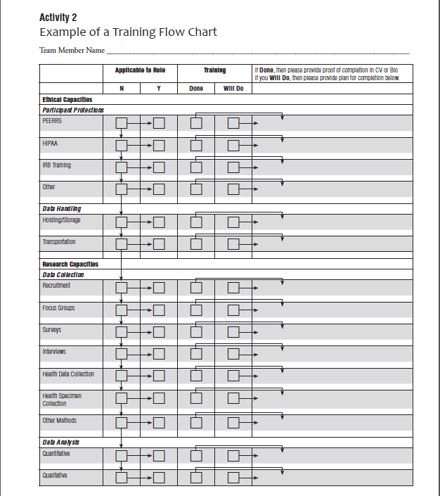
Example: Communication with IRB
Ethical Capacities
Research Capacities
Are they applicable?
Have vs. Will Do?
Plan
Notes:
Unexpected event vs. unanticipated problem
Adapting your CV
Communication plan and Training plan

Slide 49
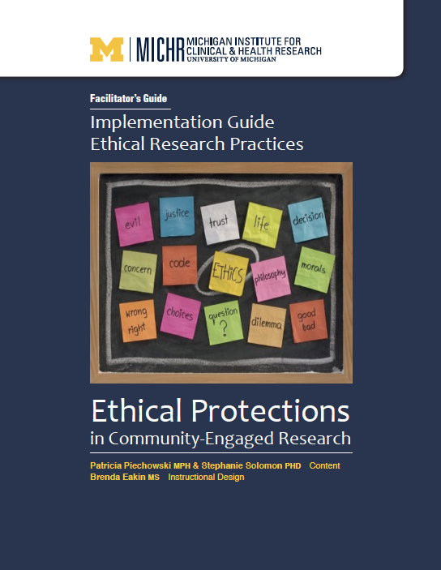
Implementation Manual
How to Use this Manual
Securing Buy-in
Cost
Recruiting Participants
Choosing Facilitators
Choosing location and time
Dealing with sensitive topics and information
Using Resources Provided
Glossary
Notes:
“Anyone who does research, especially in the community setting”

Slide 50
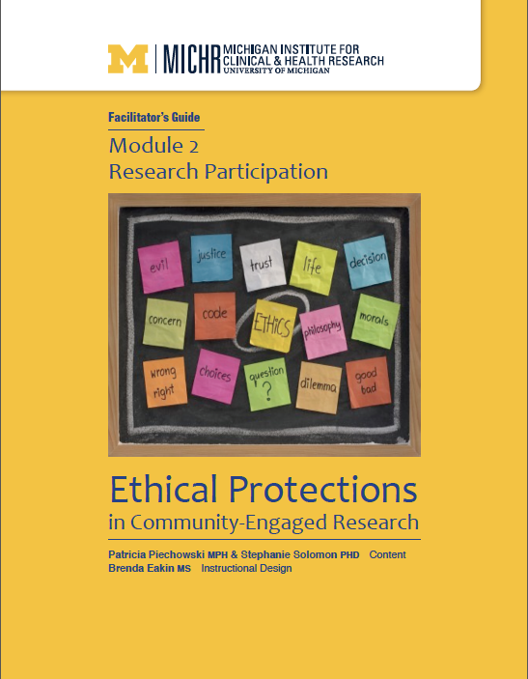
Facilitator Guides (4)
Facilitator’s Guidelines
Goals/Learning Objectives
Materials Needed
Preparation Needed
Learning Activities
Facilitator Notes

Slide 51
Important aspects:
Adaptable: Most aspects of this training can be adapted for time, audience, location, resources, etc.
Activities: Challenge trainees to apply lessons to situations they may face and brainstorm potential solutions to them.
Resources: Enables trainees and facilitators to better engage with their local organizations and IRBs.

Slide 52
Example activities:
Brainstorming
Reasons people feel pressured to participate and solutions
Ways privacy may be jeopardized in community settings and solutions
Conflicts of interest and solutions
Case studies
Difference between research and service
Pulling it all together
Informed consent role play
Person with HIV; Undocumented Immigrant; Minor; Elderly woman; Pregnant woman; Man under the influence

Slide 53
Example resources:
Research FAQ
IRB FAQ
Letter to community organization
Letter to the IRB

Slide 54
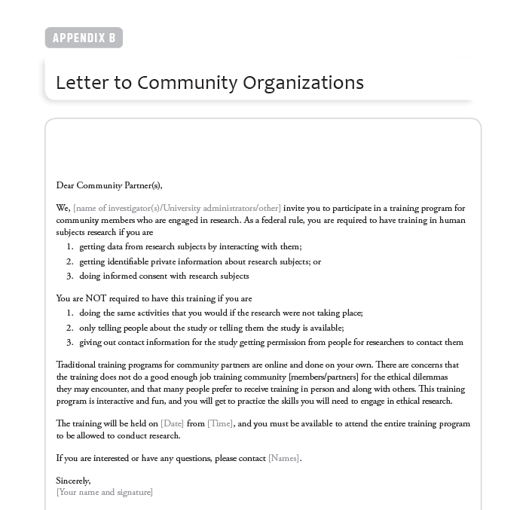

Slide 55
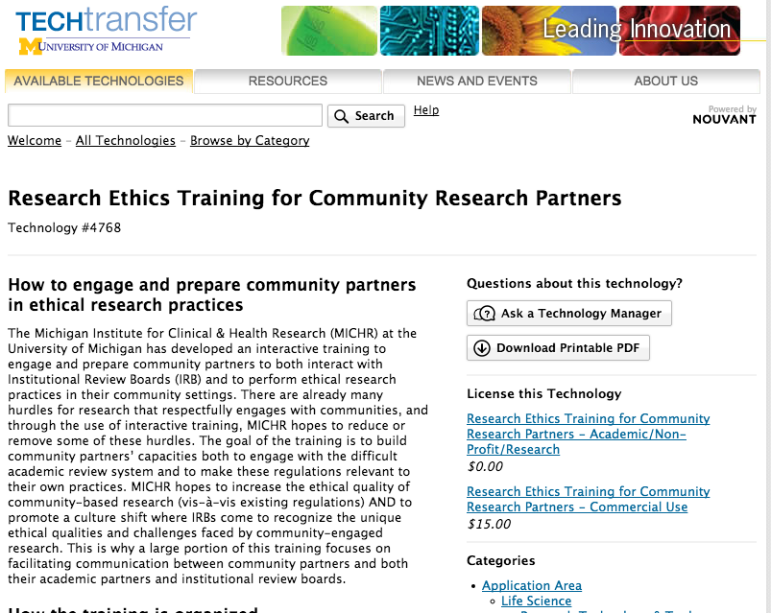
How Can I Get it?
http://inventions.umich.edu/technologies/4768_ethical-protections-in-community-engaged-research
Free license available from U of M
Fill out information and a couple of survey questions, then it is yours to use!

Slide 56
Q&A
Emily Anderson
Assistant Professor
Loyola University Chicago
Karen Glanz
George A. Weiss University Professor
University of Pennsylvania
Stephanie Solomon Cargill
Assistant Professor
St Louis University
Notes:
I want to start off with a question regarding the format of human subjects protection training programs for non-researchers. There has been specific mention about the strengths and drawbacks of online vs. in-person training programs throughout the webinar. How do you think about this issue, and how did this question impact the design of your training program?

Slide 57
Thank you!
Contact us at:
Katherine Bevans (Project Leader)
bevans@email.chop.edu
Anna de la Motte (Project Manager)
delamottea@email.chop.edu
Notes:
Thank you, I also want to remind our attendees about the prioritization task on codigital. If you’re interested in participating and don’t receive a link, please reach out to me, Anna de la Motte using the email address listed here.

