Slide 1


Slide 2
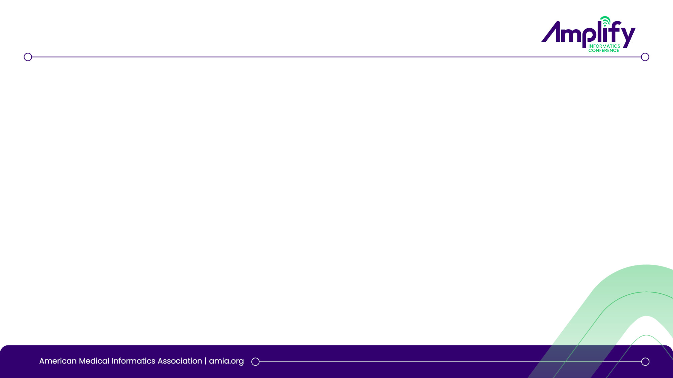

Development and Validation of an LLM-Based Pipeline for Transcranial Doppler Interpretation in Pediatric Sickle Cell Disease
Session Code: TRI24
Speaker : Sahal Master, BDS, MPH
Institution : Children’s Hospital of Philadelphia
Connect with me at masters2@chop.edu | https://www.linkedin.com/in/mastersahal

Slide 3
Disclosure of Relevant Financial Relationships
The following presenter(s) have no relevant financial relationship(s) with ineligible companies to disclose.
  Sahal Master, BDS, MPH
Notes:
I have no relevant financial relationships to disclose.

Slide 4
Learning Objectives
Describe the role of TCD in stroke risk stratification for pediatric sickle cell disease.
Explain why heterogeneous TCD reports are difficult to structure at scale.
Evaluate an LLM pipeline for artery-level velocity extraction and TCD outcome classification.
Apply key principles for deploying clinical NLP pipelines across sites.

Slide 5
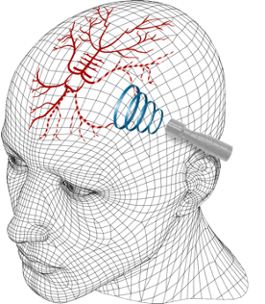
TCD identifies stroke risk, but data are unstructured
Clinical Problem
  SCD-> high risk of stroke
  Transcranial Doppler ultrasound (TCD) : flow of blood in brain
  Abnormal TCD -> highest-risk -> therapeutic intervention
Informatics/Data Problem
  TCD Findings : unstructured text in reports
  Manual data entry: error prone, resource-intensive
  Significant heterogeneity in reporting
Research Opportunity
  Scalable automated extraction solves multi-center research bottlenecks
https://rimed.com/

Slide 6
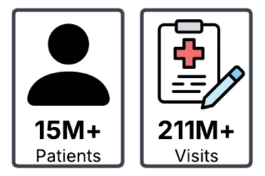
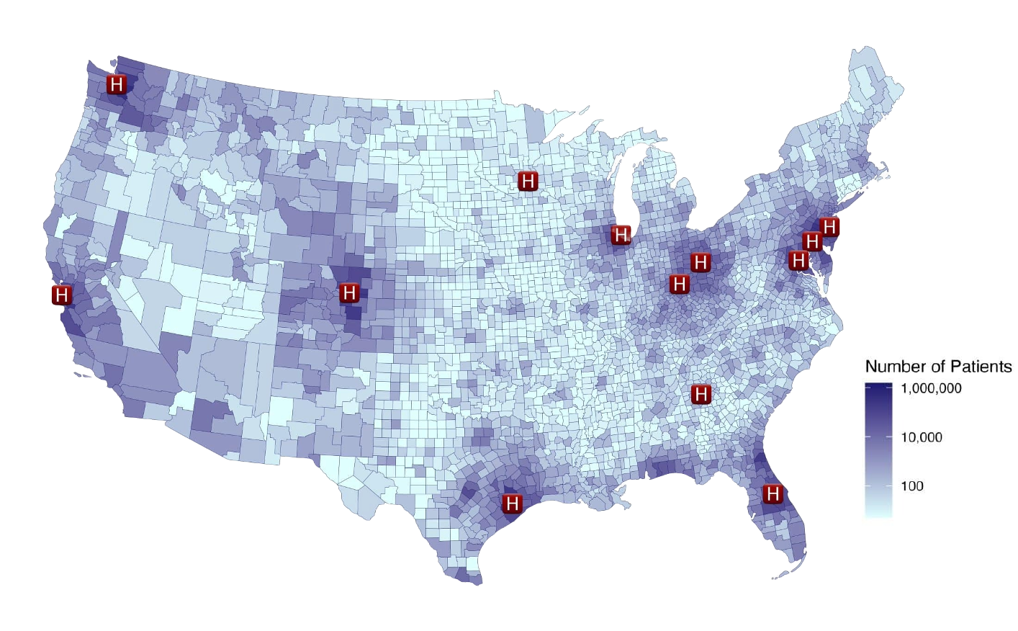


PEDSnet
National, multi-institutional network of children’s hospitals
  Includes structured electronic health record (EHR) through regular ETL
diagnoses, procedures, labs
measurements, medications, etc.
data embedded in free text, radiology scans, etc.
Unstructured data are outside the common data model

Slide 7
Objective
Develop a reproducible LLM-based pipeline to convert unstructured TCD procedure notes into structured, research-ready data across five pediatric hospitals.
Project Goals :
Create a multicenter pediatric TCD repository from procedure notes across five children’s hospitals, spanning 2009–2025.
Develop a generalizable data extraction module that can support structured data extraction from unstructured clinical notes.

Slide 8
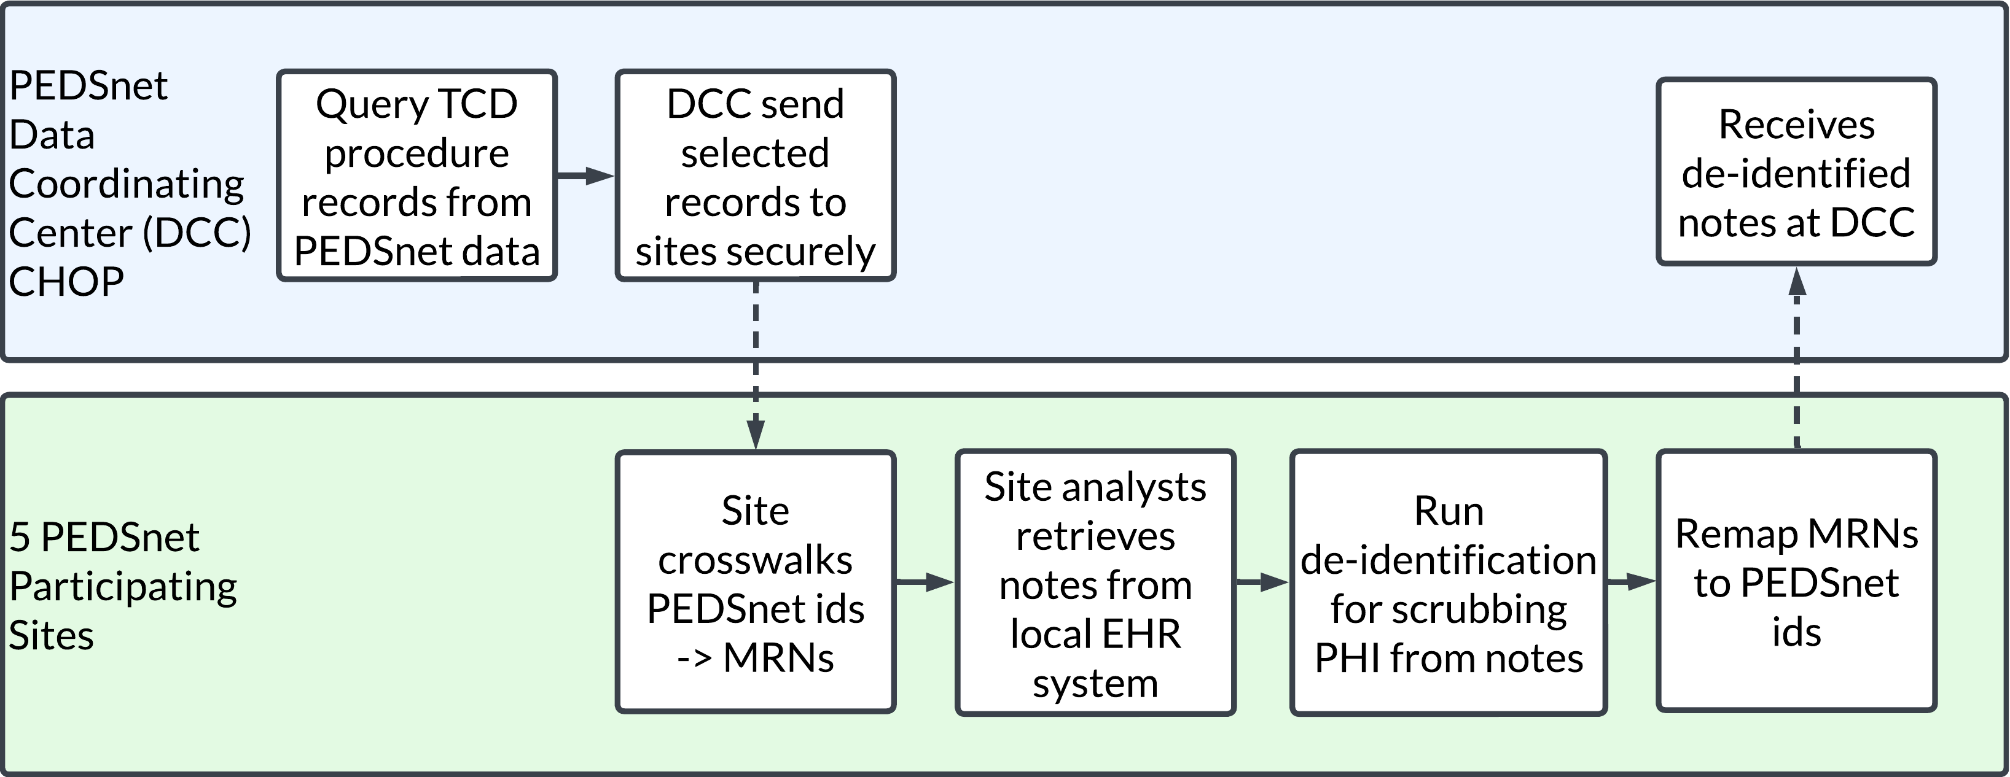
Notes retrieval

Slide 9
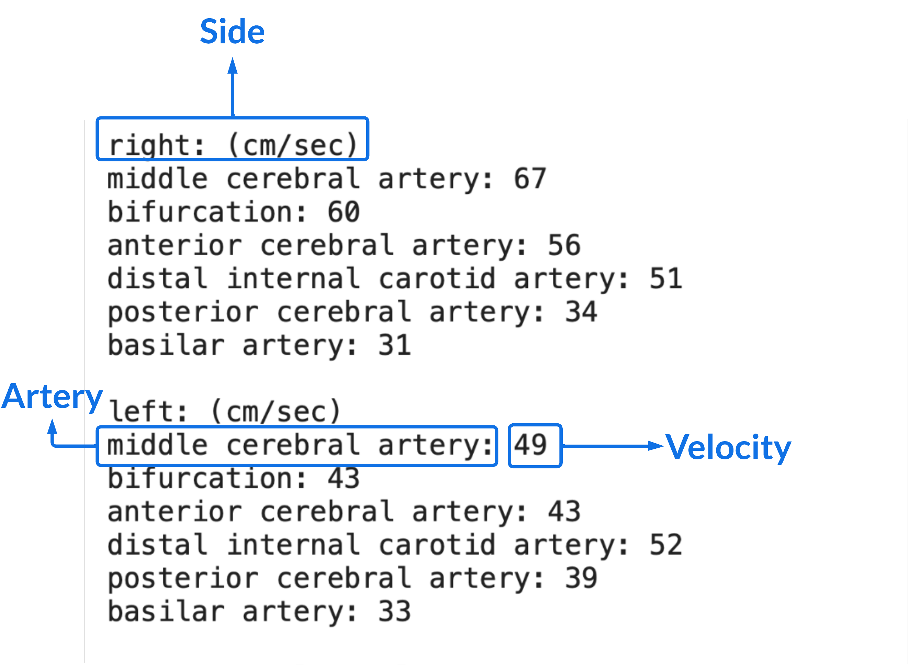
Heterogeneity limits rule-based extraction

Slide 10
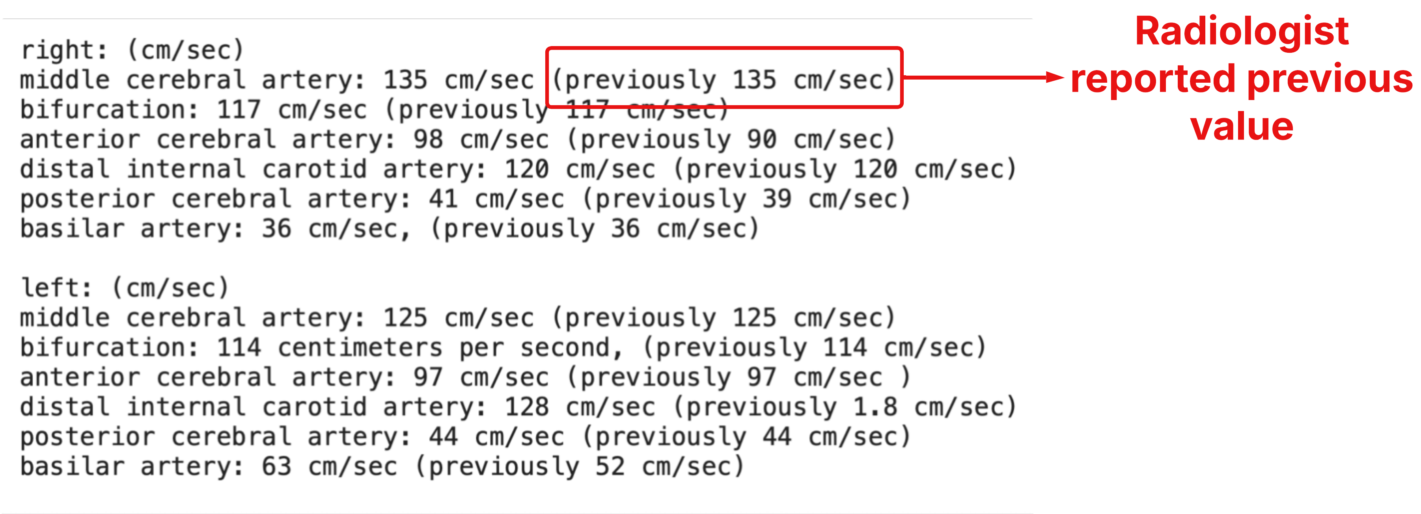

Slide 11
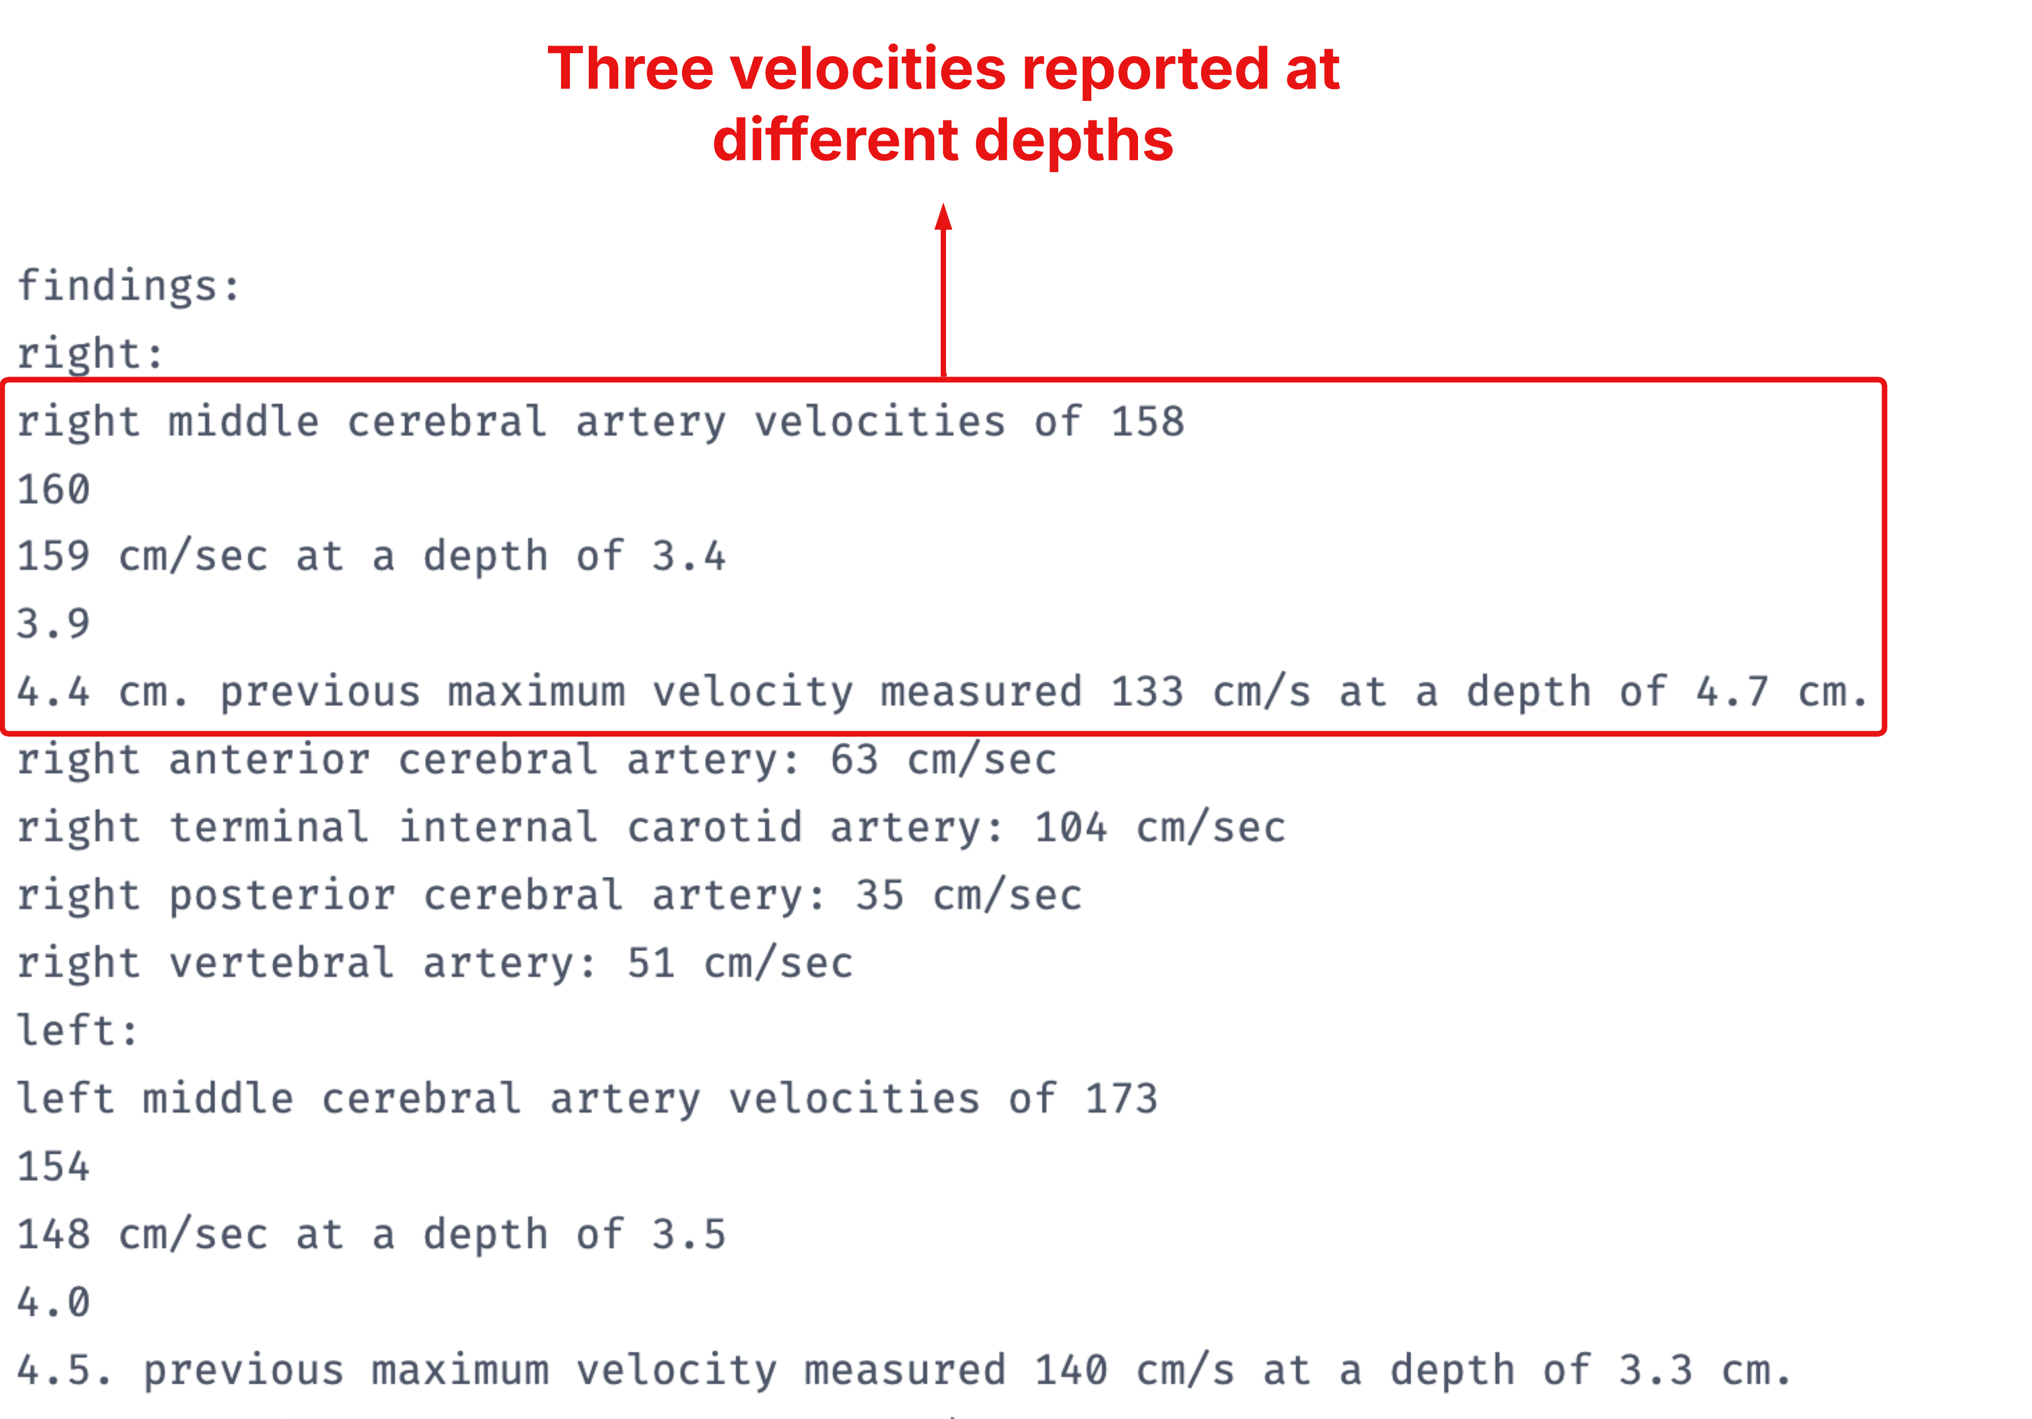

Slide 12
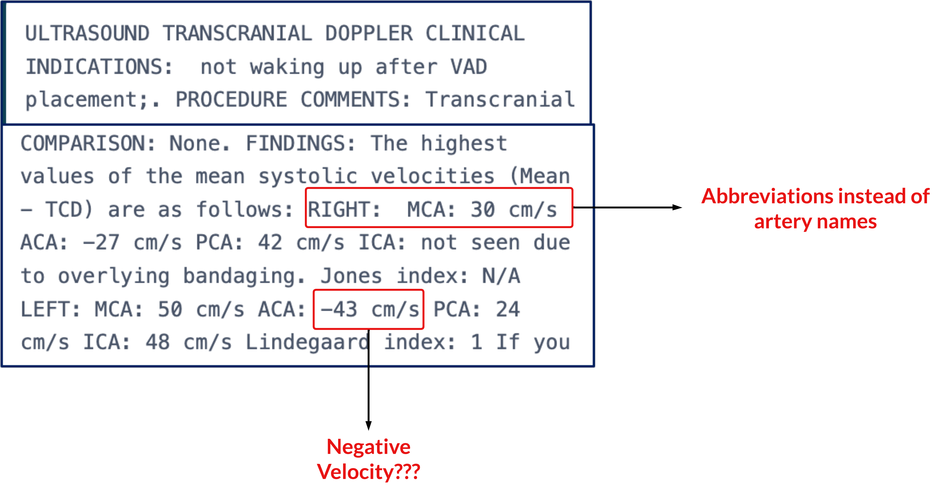

Slide 13
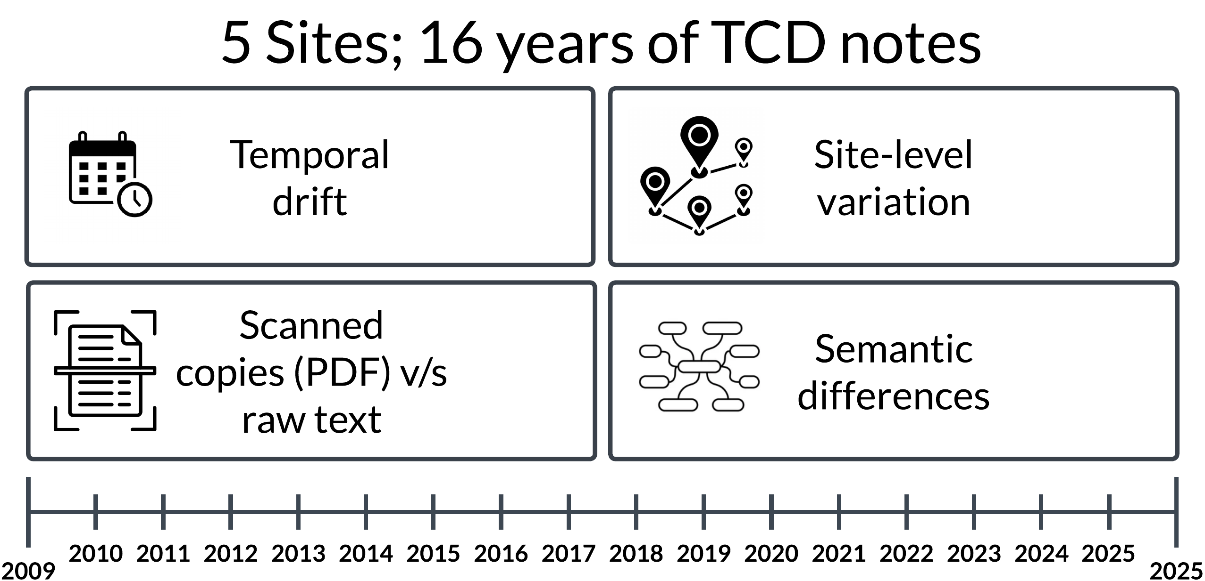

Slide 14
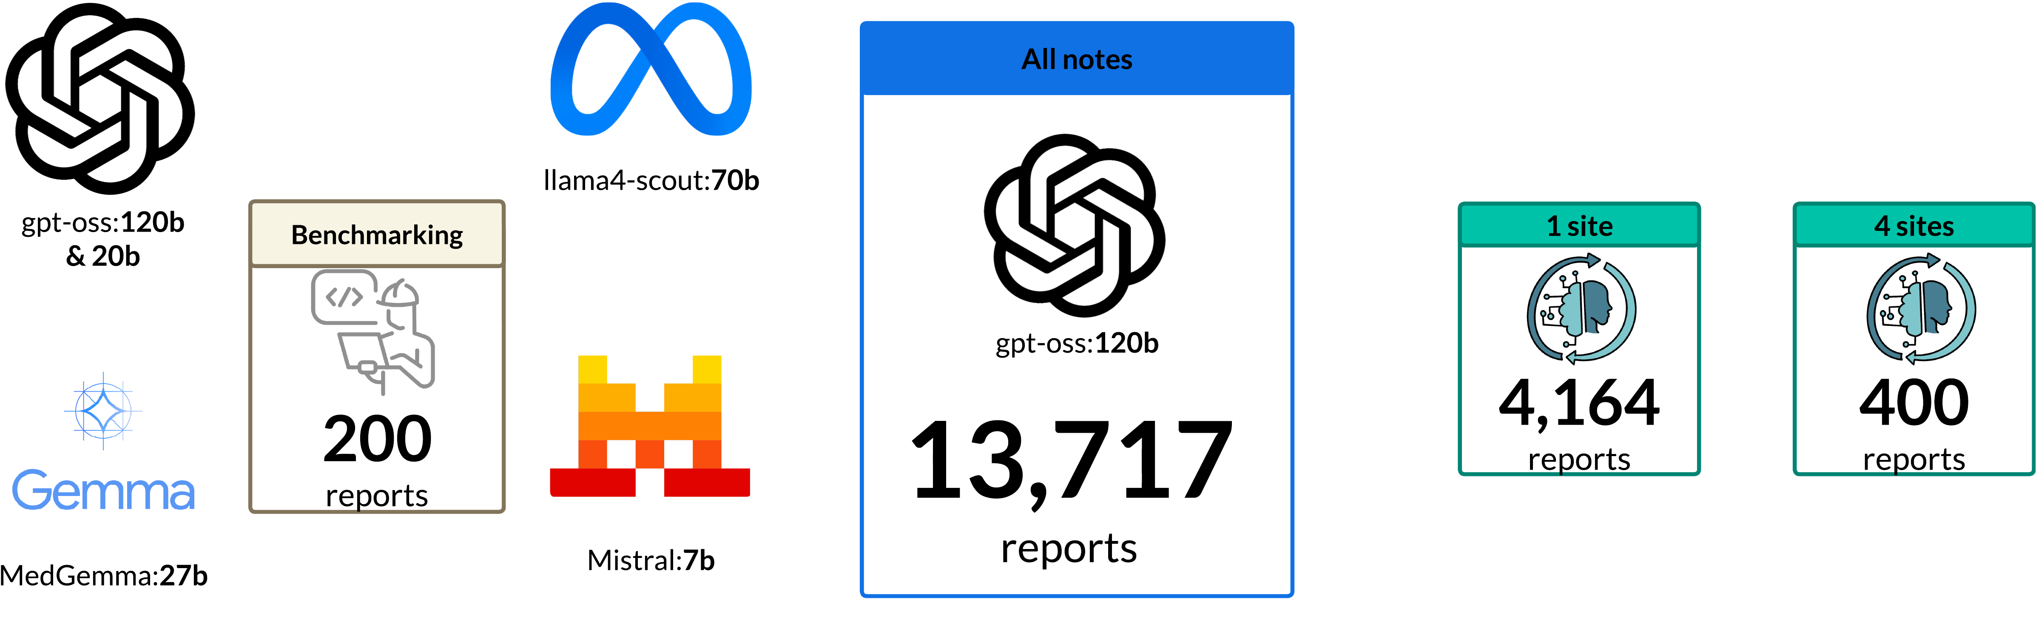
Extraction and Validation
3 reports/year/site
Benchmarking : N = 200
Human-in-the-eval-loop
Single site annotated from previous study (N = 4,146)
Stratified sampling (N = 400)

Slide 15
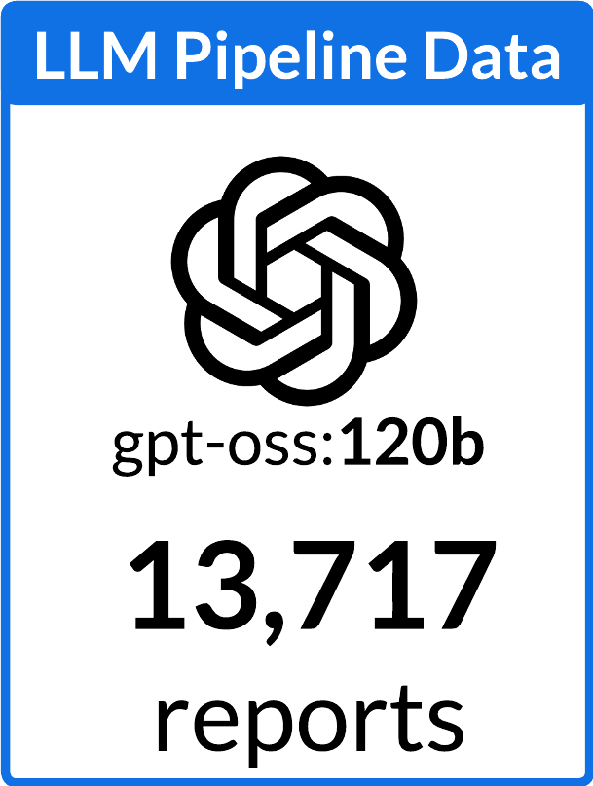
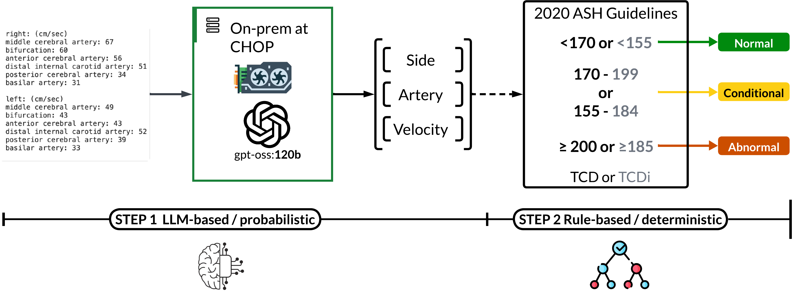
Two-step pipeline: extract → classify

Slide 16
Evaluation Framework
Evaluation task | Reference comparison | Performance metric
Artery-level velocity extraction | Exact, missed, incorrect/hallucinated velocity | Exact match rate (CI)
TCD outcome classification | Normal, Conditional, Abnormal, Undetermined | Sensitivity, specificity, PPV, NPV, F1
LLM setup: zero-shot prompting, structured output, temperature = 1, top-p = 0.6
Environment: Python 3.11, R 4.5.2, vLLM 0.13, 2× NVIDIA H200 GPUs (282 GB)

Slide 17
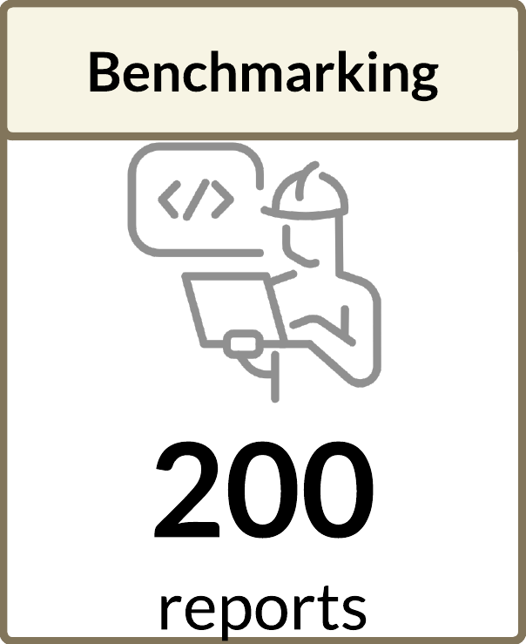
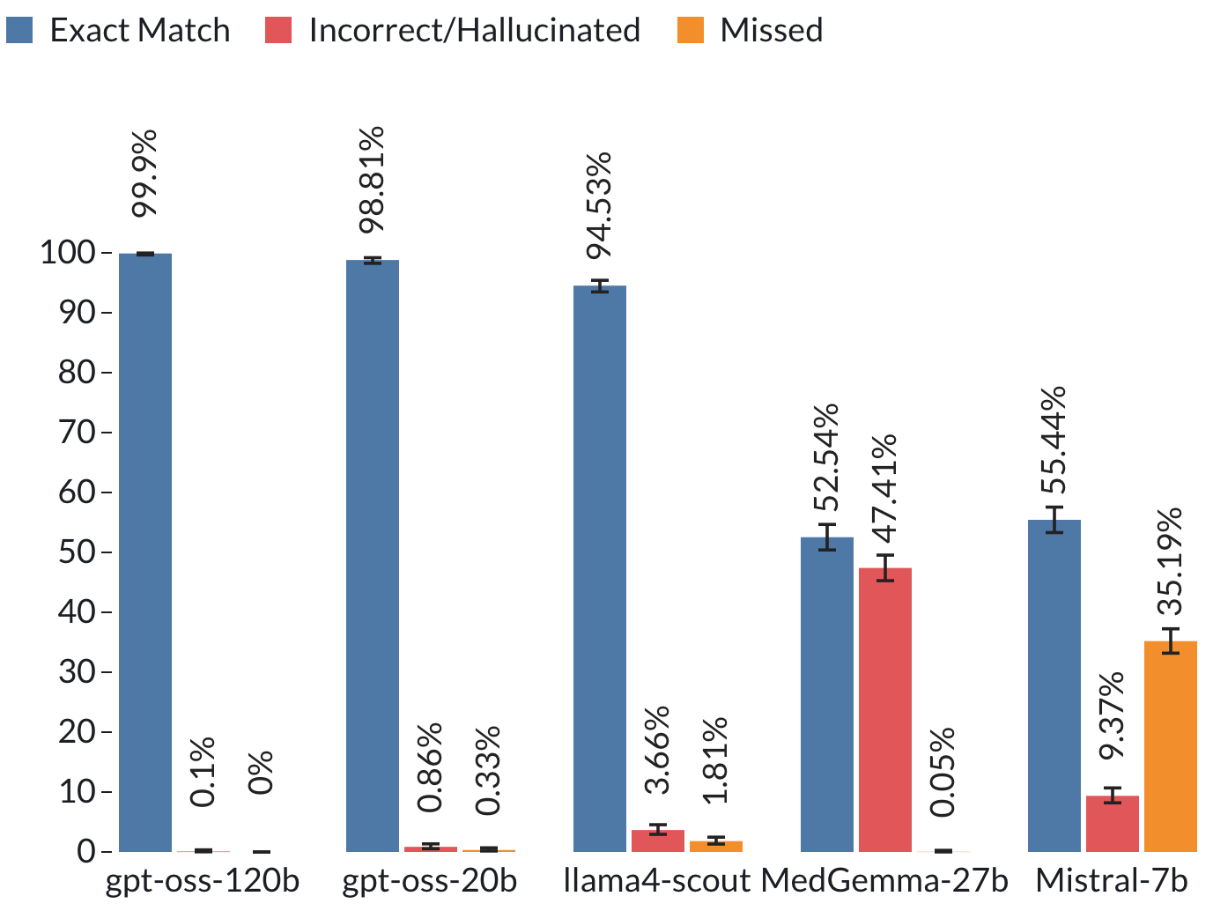
LLMs achieved high extraction accuracy
Error Analysis (N = 2130 unique velocity*artery*side)
Temporal value confusion
gpt-oss-20b and Llama4 : picked up previous or peak systolic value
Incomplete extraction (Laterality)
Llama4: skipped all or missed a side
Hallucination
Medgemma27b: Fabricated value of 100
Isolated extraction error
gpt-oss-120b missed 3 arteries

Slide 18
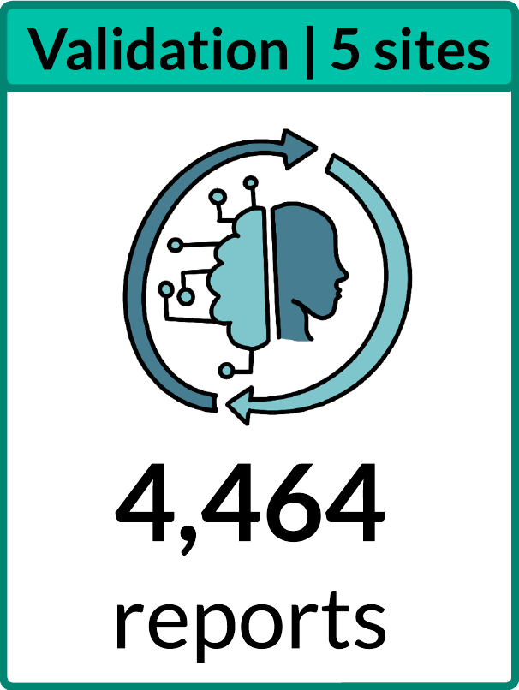
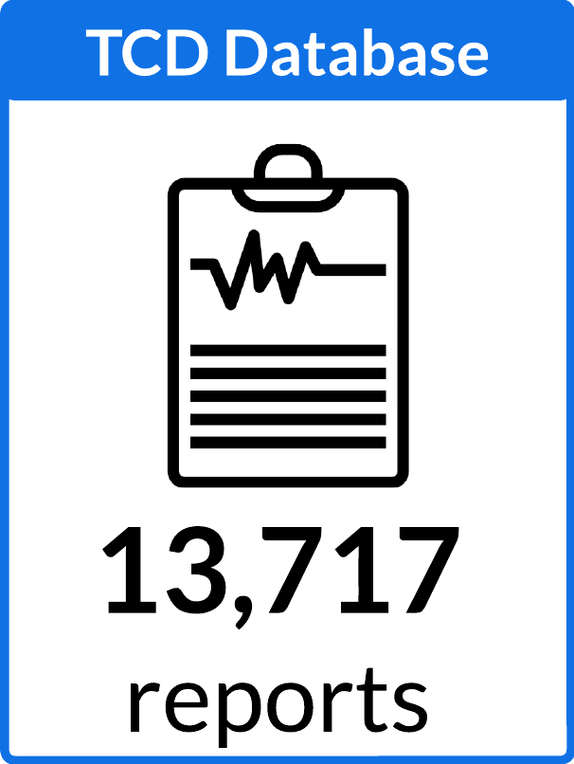
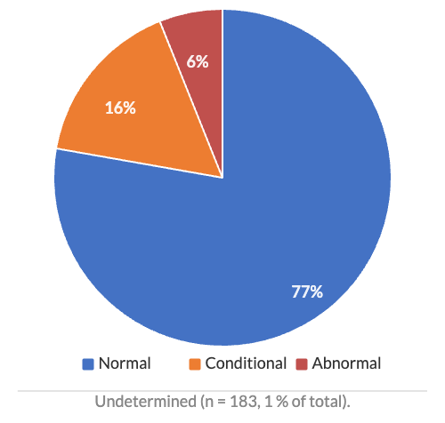
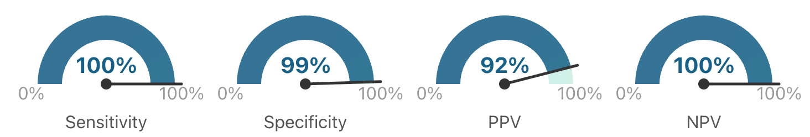
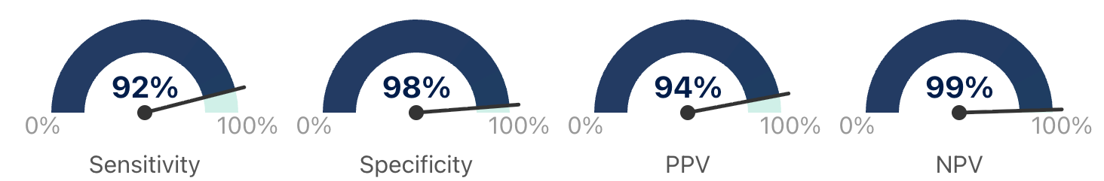
Outcome classification showed strong performance
Abnormal v/s Not-Abnormal
F1 : 0.96
Multi-class (Abnormal, Conditional, Normal, Undetermined)
F1 : 0.93
Distribution in agreement with current literature

Slide 19
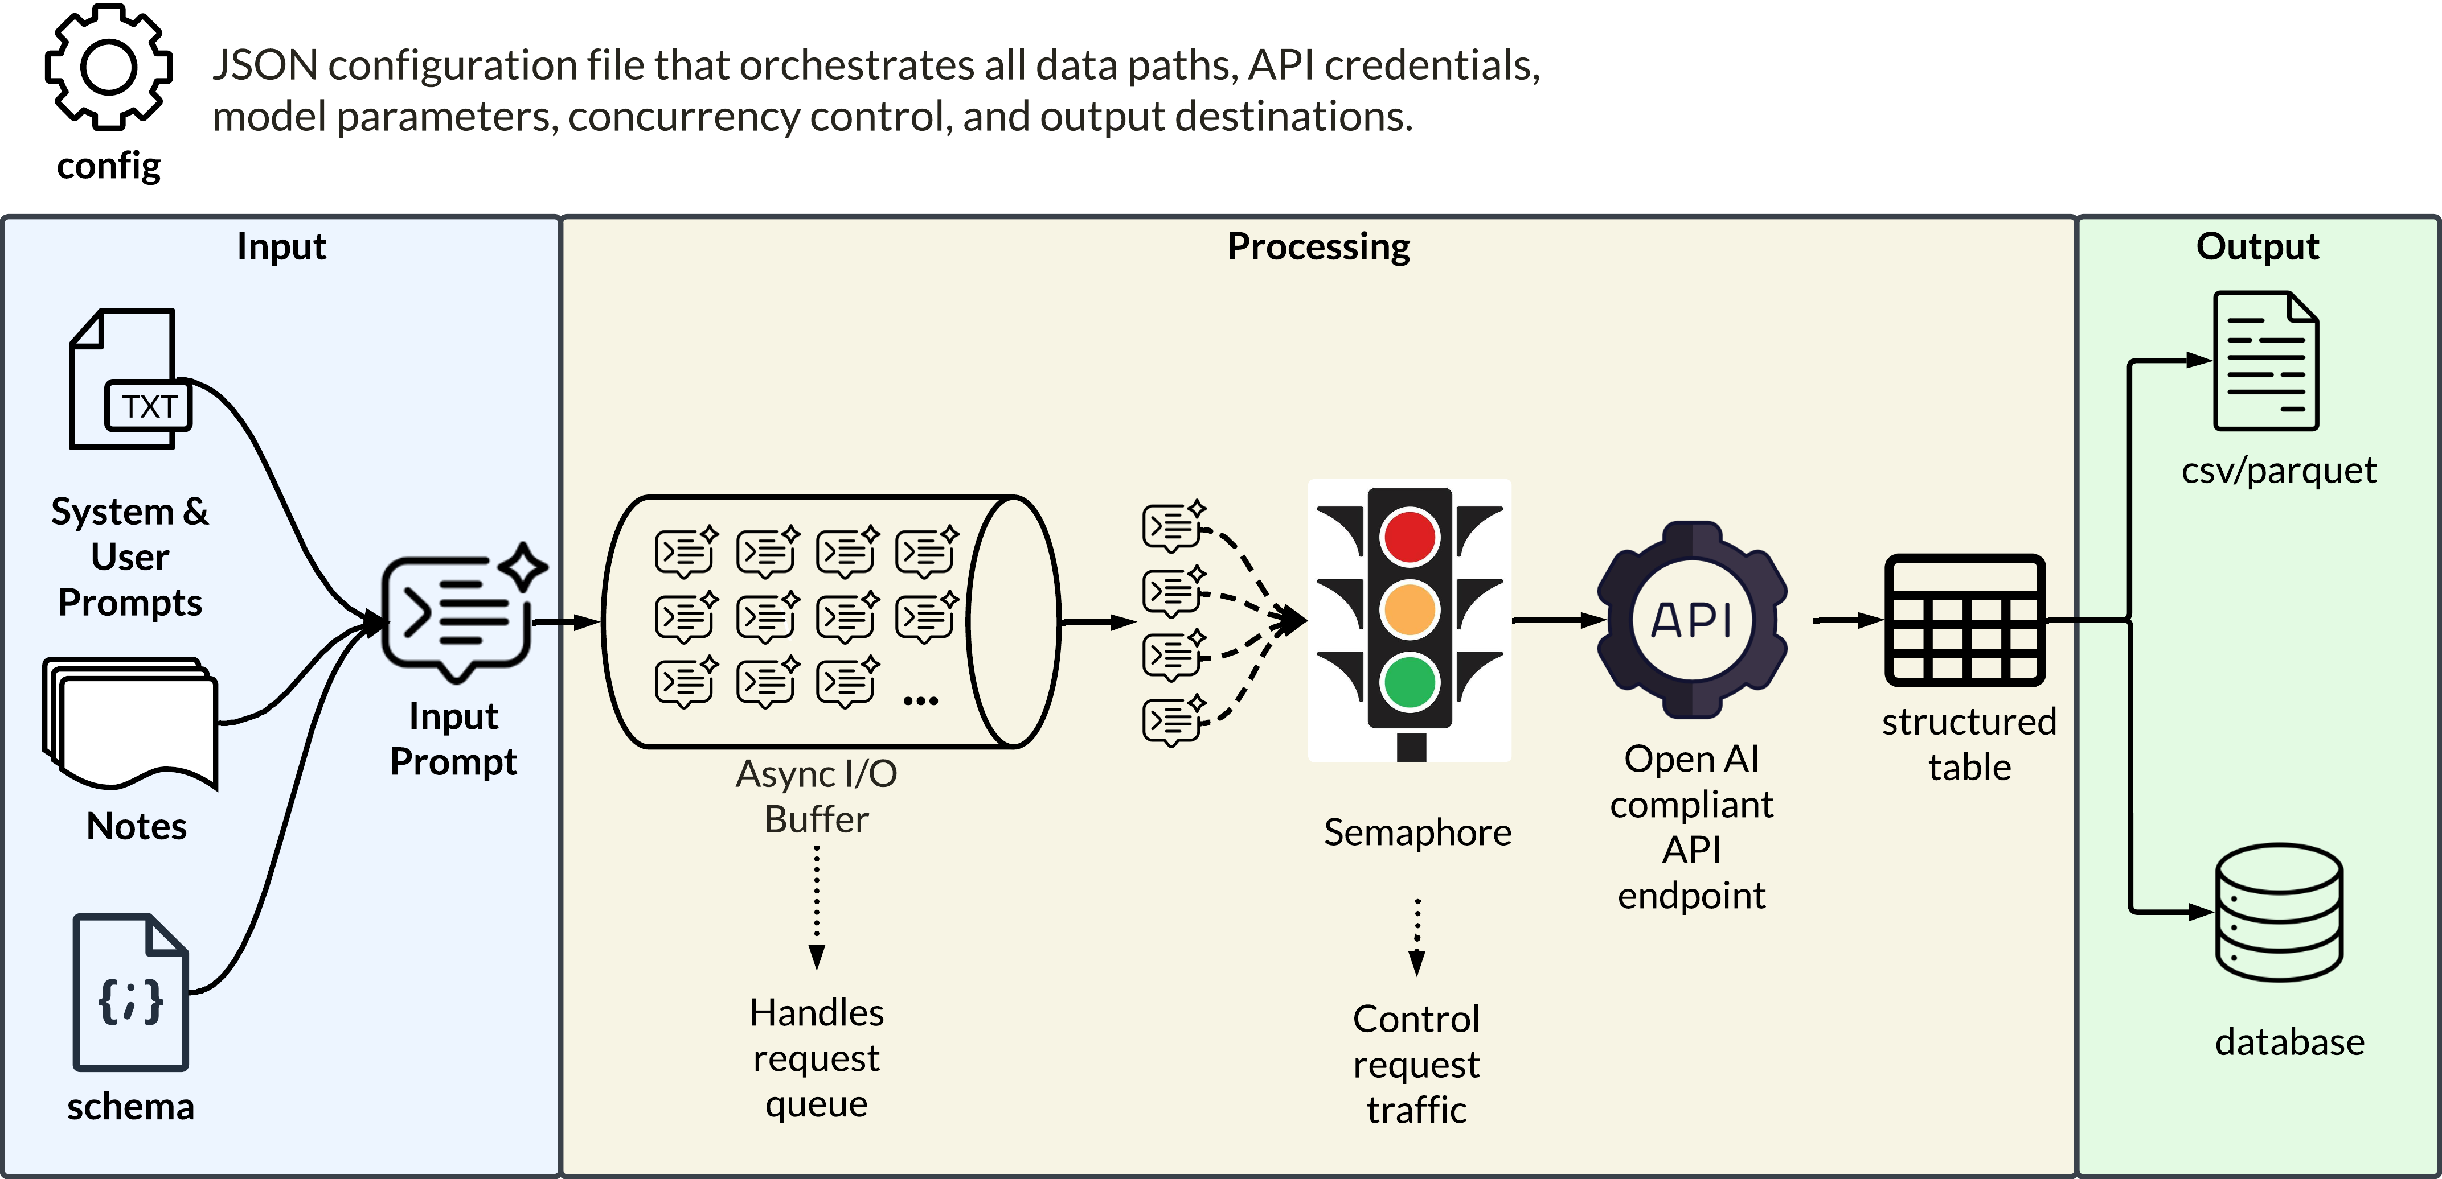
Scalable and reusable pipeline for production deployment
Built in Python as configurable cli-tool
Works with any OpenAI compliant API endpoint
Parallelized yet traffic-controlled

Slide 20
Conclusions and Future Directions
What we showed ?
  Scalable LLM pipeline for structured TCD data
  Accurate extraction and outcome classification
  Unlocks free-text clinical data
What’s next ?
  Build multicenter TCD repository
  Link with PEDSnet for real-world studies
  Generalize to other clinical domains

Slide 21
Acknowledgements
Study Team
  Sahal Master, BDS, MPH
  Aleksandra Dain, MD, MSCE
  Elana Dicocco, MPH
  Hanieh Razzaghi, PhD
  L. Charles Bailey, MD, PhD
Questions
Funding
The research reported in this presentation was conducted using PEDSnet, A Pediatric Clinical Research Network. PEDSnet has been developed with funding from the Patient-Centered Outcomes Research Institute (PCORI); PEDSnet’s participation in PCORnet is funded through PCORI award RI-CHOP-01-PS10. This presentation includes data from the Children’s Hospital of Philadelphia.
Research reported in this presentation was supported by grant 1P30HS029755 funded by the Agency of Healthcare Research and Quality (AHRQ) and the Patient-Centered Outcomes Research Institute (PCORI®) through a research collaboration. The opinions presented in this presentation are solely the responsibility of the author(s) and do not necessarily represent the views of AHRQ, the U.S. Department of Health and Human Services, or PCORI®.

